Slide 1
Transforming Data Into Action: Community Health Assessment & Public Health Improvement Plan
Kristin D. Pulatie, JD MPH
Notes:
Update today on new portions of our presentation that will be tailored to individual audiences to introduce the PHIP

Slide 2
Mission and Vision
Our Mission: To protect human and environmental health and inspire well-being in our community.
Our Vision: We are leaders aiming to achieve healthy communities and health equity.
SJBPH believes in the fundamental right of each individual to attain his or her fullest potential of health.

Slide 3
Public Health Act of 2008: Core Services
Administration & Governance
Assessment, Planning, and Communication
Communicable Disease prevention, investigation, and control
Emergency Preparedness and Response
Environmental Health
Prevention and Population Health Promotion
Vital Records
Notes:
The Public Health Act of 2008 is a law that creates a benchmark for local public health in Colorado.
Each county must ensure that these 7 service areas are available to their residents. This can mean that counties have their own health departments or contract the activities out to other providers.
Some of them, like communicable disease, might seem like obvious functions of a health department.
But what about activities like Administration and Governance, or Assessment and Planning?

Slide 4
Assessment & Planning
Community Health Assessment (every 5 years)
Public Health Improvement Plan (every 5 years)
Ongoing program monitoring
New program development
Notes:
Assessment and Planning is a core public health service in the state of CO. What does that mean?
Counties must ensure that every 5 years, a community health assessment is performed to get feedback about health issues from residents.
Counties must also ensure that every 5 years, they create a public health improvement plan, or PHIP, to respond to the needs facing their residents, and plan for future health needs in their communities.
At SJBPH, the A&P team works on the CHA, the PHIP, and also monitors program performance as well as identifying areas of opportunity to create new programs.
* Note: Many hospitals are also required to assess and plan for community health, however they are on a 3-year cycle, so the assessment and planning phases do not always match up with local public health cycles.

Slide 5
Community Health Assessment (CHA)
Survey was available to Archuleta/La Plata residents
January through April 2018
20 questions about community health
Prioritize issues of importance
PLUS
Data from multiple national, state, and regional sources
Notes:
There are many ways to conduct a Community Health Assessment, and local agencies have the flexibility to create assessments that work best for the populations they serve.
SJBPH created a 20 question survey that was open from January through April of 2018.
The survey was available in English and Spanish, in paper or online formats.
The survey asked people to identify issues that impacted their health, and then rank the importance of those issues to help us prioritize our planning activities.
SJBPH staff also reviewed data from multiple sources to learn about the issues that impact health in our counties.

Slide 6
Completed Surveys
Total of 1,082
248 Archuleta County
834 La Plata County
27 in Spanish
Notes:
1082 Total La Plata 55,589 Archuleta 13,315 Combined 68,904 2017 Estimates
This sample is representative of the population size of the counties that we serve.
Adults LPC 44,861 AC 10,994 Total 55,855
27 in Spanish
12 in La Plata; 2987 18+ speak Spanish 6.7%; 18+ Speak English less than very well 473 1.1%→1.4% of LPC surveys were in Spanish
15 in Archuleta; 1080 18+ speak Spanish 9.8%; 18+ Speak English less than very well 247 2.2%→6% of AC surveys were in Spanish

Slide 7
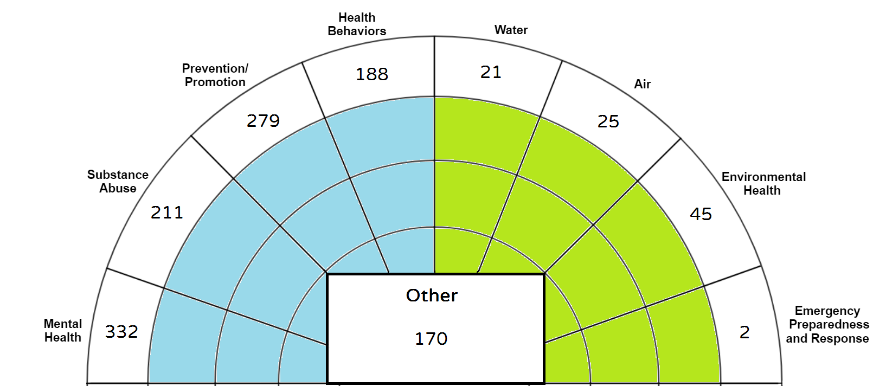
Q3: Most Important Health Issue
Notes:
In your own words, what do you believe is the most important health issue facing the residents of your county?
Remember SEM→mental health, substance abuse, prevention/promotion, health behaviors, water, air, environmental health, EPR
Used categories to start coding the open-ended answers
Responses could end up in more than one category
Responses show us that community members might not always think of traditional public health activities when they consider what makes them healthy
Also remember that this survey occurred in the winter and early spring, before wildfire season, so issues such as air quality or emergency preparedness and response may have ranked higher later in the year. The survey offers a snapshot of concerns, but does not exhaustively list every issue that people think about when they think about health.
Mental Health: suicide, access to mental health care, services and awareness 26%
Substance Abuse: alcohol, drugs, addiction 16.5%
Prevention/Promotion: access to care, affordable insurance, chronic diseases, screenings, vaccines 21.9%
Health Behaviors: Obesity, lack of exercise, food, smoking 14.8%
Water: Water contamination 1.6%
Air: Methane and air pollution. 2.0%
EH: 3.5%
EPR: water supply and cleanliness; emergency response times across county .2
Other: affordable housing, homelessness, poverty, social isolation 13.4%

Slide 8
Top Concerns, Prioritized
(On a scale of 1-4)
Suicide/suicide attempts = 3.64
Affordable housing = 3.61
Substance abuse = 3.60
Poverty = 3.29
Availability of jobs/economic opportunity = 3.27
Notes:
Respondents were also asked to rank a list of health issues on a scale of importance, where the higher the score, the more important the issue.
The top 5 issues selected by respondents had high scores on the scale, and were closely related.
All of these issues can be related to “social determinants of health” → “Our health is also determined in part by access to social and economic opportunities; the resources and supports available in our homes, neighborhoods, and communities; the quality of our schooling; the safety of our workplaces; the cleanliness of our water, food, and air; and the nature of our social interactions and relationships. The conditions in which we live explain in part why some Americans are healthier than others and why Americans more generally are not as healthy as they could be.” (Healthy People 2020)
* If you have a hard time getting a job that pays a living wage, you may experience more stress and turn to substances to cope. Or you may spend so much on rent due to lack of affordable housing, that you no longer have money for healthy food or medical care. All of the top concerns are linked.

Slide 9
What’s Missing?
Environmental Health
Chronic Disease Prevention
Public Health concepts
Emergency Preparedness
Notes:
But what’s missing from those top concerns?
Other issue areas that also impact the health of our communities.
Without clean water, clean air, or a safe food supply, it is very difficult for people to be healthy. Environmental Health is a major public health category that was not specifically called out by survey-takers but that we know is critical to health and well-being.
Additionally, while suicide is a very visible and emotionally difficult cause of death in our region, chronic diseases (such as cardiovascular disease or cancer) cause more deaths or years of life lost than suicide.
Public health concepts, such as getting immunized to prevent disease, are simple actions that when taken can improve health for the vast majority of people.
And in a rural area of CO that can experience winter storms, wildfires, flood, drought, etc., we know that being prepared to take care of yourself during an extended power outage, or to evacuate to a safer location, is critical to health and safety.
That does not mean that we ignore either suicide or chronic disease – it means that we cannot rely only on a survey to help determine future activities of the local public health agency.

Slide 10
Public Health Improvement Plan (PHIP) should reflect…
Statutory and regulatory obligations
Community concerns
Issues of statistical need/impact
Professional experience and expertise
Notes:
We know that a survey alone is not enough information to design a 5 year plan for our organization. So what should we consider?
The PH Act of 2008 – our legal obligations (LAW)
CHA results – what our community wants us to focus on (CHA)
Data – the numbers that tell us what issues have the greatest impact on health in our region (CHA)
Expert knowledge – what our staff and leadership know about the public health system, emerging trends, threats, and opportunities (AHA!)

Slide 11
2019 – 2023 Public Health Improvement Plan
Notes:
Taking all of that into consideration – our legal requirements, what our community thinks is important, what the data tells us is important, and what our staff tells us to prepare for – we created this 5 year PHIP.
We will discuss each issue area, but something to remember about a PHIP is that it needs to be specific enough to provide a roadmap for forward progress, but nimble enough to allow us to focus on new health issues as they emerge.
For example, in our last PHIP, we identified “access to care” as a priority issue. When more Coloradans could access health insurance through the Affordable Care Act, uninsured rates went down in our counties. This does not mean that access to care was solved, and we continue to work on projects that help people find appropriate health care, but it meant that our focus could shift to an emerging trend in our region: suicide prevention.
So a PHIP must outline the path to success, while realizing that we may encounter novel obstacles along the way.
Our new PHIP identifies 7 issue areas, 3 of which are “high priority”, and applies 3 universal goals to each issue area to help us improve local health.

Slide 12
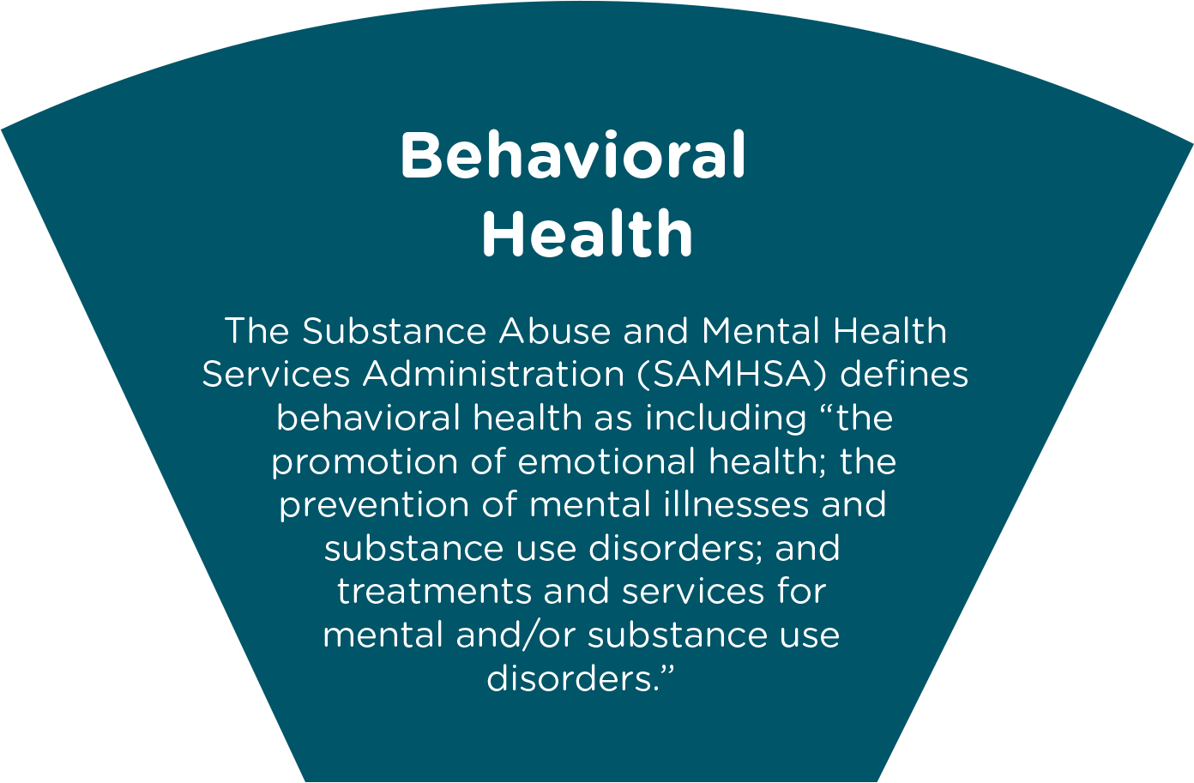
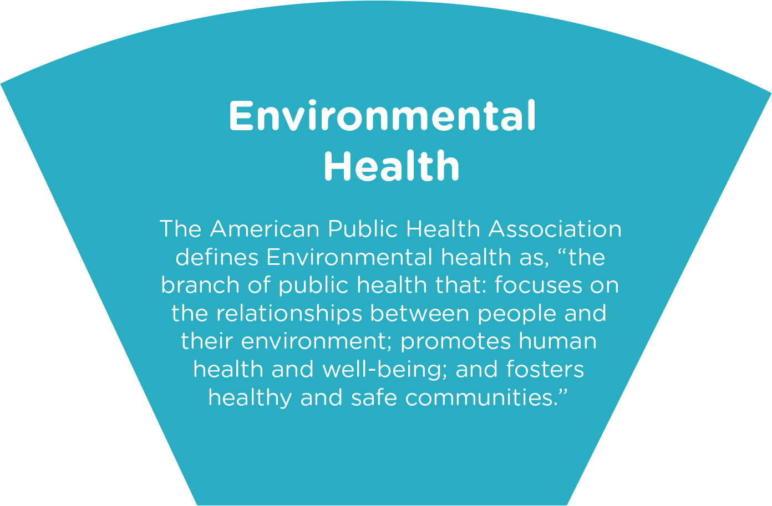
Top 3 Priorities
Notes:
So first, let’s talk about our issue areas. The top 3 priorities are:
Social Determinants of Health (things like the zip code in which you live, your education level, where you work)
Behavioral Health (which includes both mental health and substance abuse)
Environmental Health (everything from planning healthy cities to air and water quality)
The first two were clearly identified in the CHA as the issues of highest concern among survey respondents.
Environmental health was identified by staff as a critical issue that will need additional focus over the next 5 years in order to keep our community healthy.

Slide 13
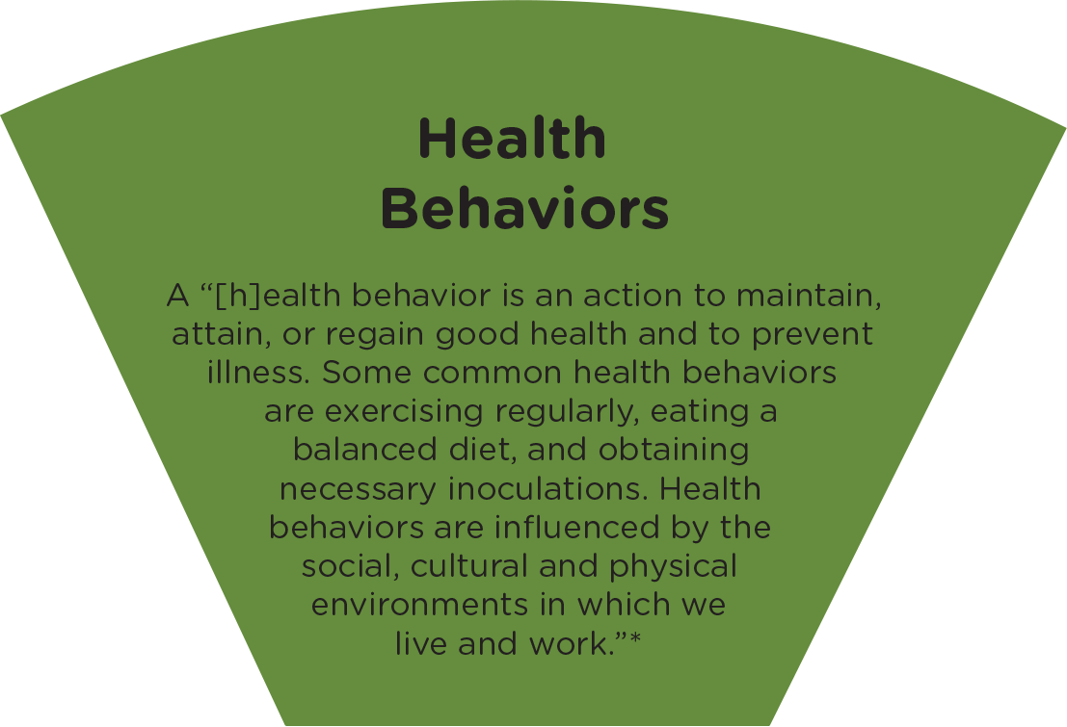
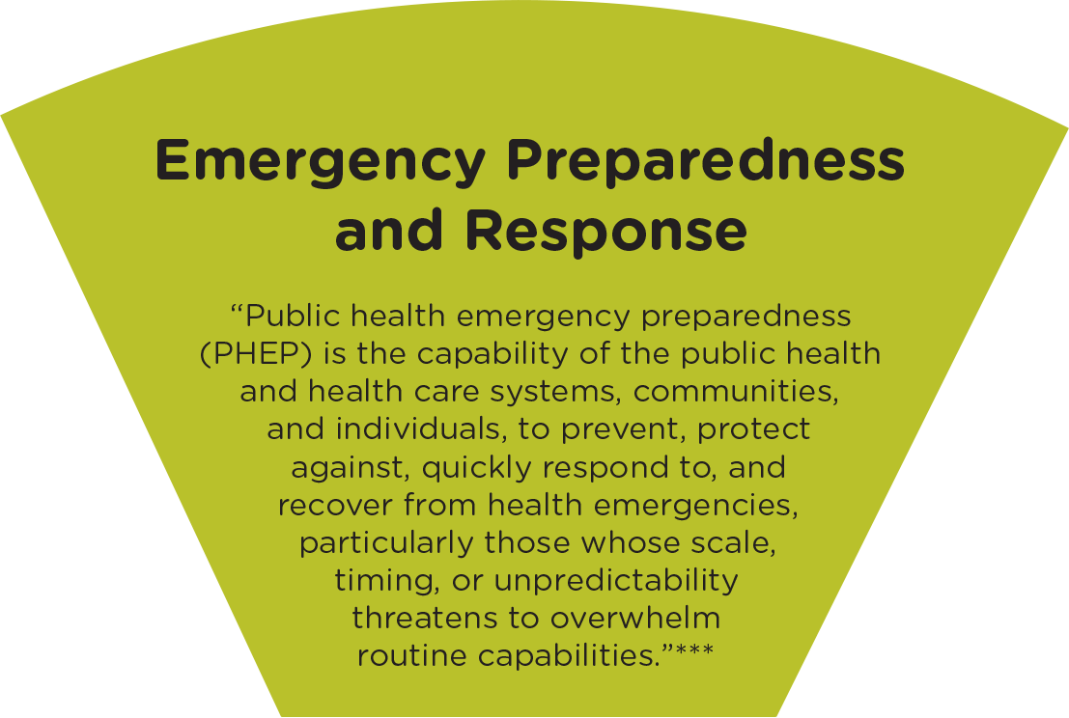
Additional Priorities
Notes:
We also identified 4 additional priority areas that we must address to improve population health. While they were not selected as “urgent”, they are nonetheless important, and we will continue to provide services in these areas and to develop new ways of responding to community need. Often these priorities are impacted by success in working on the top priorities.
For example:
A health behavior is a choice that a person can make to improve their individual health, such as wearing a seatbelt, getting a flu shot, or eating healthful foods. However these choices do not exist in a vacuum – if a person spends half of her income on rent because her community has no affordable housing or lacks economic opportunity, she may have a harder time shopping for healthful foods. By addressing SDOH (a priority area), we should also be able to improve opportunities for people to have healthier behaviors.
Another example is emergency preparedness. If you cannot afford to buy food during non-emergency situations, it might be hard for you to create a kit that has 3 days worth of food stored in case of an emergency.
We also know that Communicable Disease prevention and investigation is a keystone activity of public health. We are the profession that is tasked with these activities and that has expertise in communicable disease prevention, so it will always be a priority activity.
And clinical care linkages are important because we often see people for non-health care services, but are able to refer them to or connect them to appropriate services in the community that they may not have known about.

Slide 14
How will SJBPH address health issues?
Strategic Plan:
Goals, Objectives, Strategies, Activities
Programs and resources
Measure progress of existing efforts
Develop innovative approaches to health issues
Notes:
Now that we have priority areas to address, how will we determine whether we have made progress on those issues, and improved the health of our communities?
First, we will develop a plan that includes goals, objectives, strategies, and activities for each issue area.
Then we will use that plan to measure our efforts and develop new programs as needed.
What types of goals will guide our efforts? We created 3 goal statements to describe the work we will do across the agency to improve each issue area.

Slide 15
Notes:
#1 is Community Resilience.
This goal states that we will improve the health of our community by making sure that all residents know about programs and resources that improve their health. We will also make sure to share awareness of the importance of the public health programs we provide. And finally, we will make sure that we remove barriers to accessing resources that improve health. What does this look like to the average resident?
AWARENESS ACCEPTANCE ACCESS

Slide 16
Goal 1 Application: Communicable Disease
Disease education
Prevention concepts
Low-cost vaccines
Notes:
What do these goals look like in practice, to our community members?
If you apply this goal to Communicable Disease, for example:
We improve awareness of vaccine-preventable diseases in the community by educating the public about how to prevent or avoid disease.
We use evidence to demonstrate how public health concepts (like hand-washing and immunizations) can prevent the spread of disease.
We remove barriers to accessing immunizations by providing low-cost vaccines through our clinic.

Slide 17
Goal 1 Application: Health Behaviors
Evidence-informed education
Explanation of data
Teaching practical skills
Notes:
If you apply this goal to Health Behaviors, for example:
Our staff might work with parents to explain the importance of using an age-appropriate restraint device (car seat) every time they transport their children in a car.
We can use evidence about traffic safety to show why it is important to use car seats.
We remove barriers to access by training our staff to be certified car-seat technicians who can help parents learn how to use car seats appropriately and safely.

Slide 18
Goal 1 Application: Clinical Care Linkage
Ask clients for more information
Discuss health care options
Make referral; connect client to care
Notes:
If you apply this to Clinical Care Linkage, for example:
Our staff who sees a client for one type of appointment might ask whether that client has access to a health care provider, and if not, determine what the barriers to access are.
Our staff might also discuss why routine health care appointments are important to overall health
Our staff might help that person access health care insurance on the Exchange, if the barrier to care was insurance coverage. Or we might work on a program to bring telehealth services to our office, if the barrier to care was lack of providers in our area.
These 3 examples should give you a good idea of how we apply a stated goal of “community resilience” to our everyday work in multiple health issue areas, and explain how a community member might be impact by our work in this goal.

Slide 19
Notes:
Our next Goal area, Goal 2, is to improve our organizational capacity to serve our community across all 7 issue areas. This means that we will try to ensure that funding exists to provide programs that the community needs, that we will make sure our employees have the training they need to perform their jobs, as well as opportunities to seek additional learning, and that our organization will follow best practices in areas like finance and administration. This also means that staff and leadership will provide our Board of Health with all of the tools necessary to perform their statutory roles.
Let’s look at how we might apply Goal 2 to a few health issue areas to have a positive impact on community health.
The result for the public is that our staff is well-trained and prepared to perform their jobs at a high level, our programs are sustainably funded, and our Board of Health makes recommendations and adopts policies in accordance with appropriate legal authority.

Slide 20
Goal 2 Application: Environmental Health
Funding Opportunities
Certification and Cross-Training
Fiscal Responsibility
Legal Authority
Notes:
An example of Goal 2 as applied to Environmental Health might look like:
Applying for grant or funding opportunities to provide radon testing kits or well water testing kits to the public.
Making sure that all EH employees who perform restaurant inspections are appropriately certified to do so, and carry out inspections uniformly in the field.
Offering opportunities for EH employees to cross-train – while one may specialize in restaurant inspections, we can also train them to perform septic permit inspections
Following our budget carefully and submitting invoices to our funders on time, and
Educating the BOH about changes in CO law that may impact how we perform things like inspections or transfer of real estate title

Slide 21
Goal 2 Application: Social Determinants of Health
Gathering and analyzing data
Seeking collaboration
More effective communication
Understand and share community resources
Notes:
Another way to understand Goal 2 is to apply it to SDOH.
An example as applied to Social Determinants of Health might look like:
Using data to understand what challenges people in our communities face when trying to live healthy lives (lack of housing, lack of economic opportunity, discrimination)
Seeking grant programs that address those issues, either for SJBPH to administer or in collaboration with an appropriate community organization (for example, help a housing organization apply for a grant to get first month’s rent for people who qualify)
Train our employees on the importance of asking about SDOH in appointments with clients – if someone is struggling to make their immunization appointment on time, is it due to lack of transportation? Is there a resource to which we can connect them?
Seek opportunities to learn about other resources in our communities, so that our staff can refer people to the services they need, even if we do not provide them
Educate our BOH about our efforts, and discuss additional recommendations for new programs or policies that would support community collaboration to address large SDOH issues.
*** The result for the public is that our staff is well-trained and prepared to perform their jobs at a high level, our programs are sustainably funded, and our Board of Health makes recommendations and adopts policies in accordance with appropriate legal authority.

Slide 22
Notes:
Our final goal area, Goal 3, is designed to use data and scientific evidence to both address existing public health issues as well as plan for new issues that may evolve or arise in the future. This goal can support our assessment and planning activities by calling out that we will either use available data sources or even create our own to assess community health needs.
Again, we have some examples of how Goal 3 will be applied to our priority issues to make a positive impact in our community.
The public may experience an increase in services or training as a result of our staff using data to seek prevention funding.

Slide 23
Goal 3 Application: Emergency Preparedness
Observe
Quantify the issue
Design a solution
Share knowledge
Notes:
An example of this as applied to Emergency Preparedness might look like:
Our staff observes that some people in our community had a more difficult time preparing for and evacuating during a wildfire event
The data tells us that many people in our region think that being prepared for an emergency is important, but they have barriers for making an emergency kit or plan
We use this information to seek grant funding to support preparedness efforts with partner organizations and the clients they serve
We recommend to our coalition partners who also work on preparedness that they use inclusive, equitable planning processes to support the needs of our community

Slide 24
Goal 3 Application: Behavioral Health
Listen to community members
Research their feedback
Apply for programs to address issue
Partner with stakeholders on prevention
Notes:
Another example, as applied to Behavioral Health, might look like:
Our staff hears that our communities have a lack of access to mental health providers, and observes that many clients cannot get in to see an appropriate provider
Data shows us that western Colorado has an increase in instances of depression and suicide attempts/completions
We use this data to apply for funding that supports innovative, community-based behavioral health funding
This funding supports a suicide prevention coalition that draws together many organizations and concerned citizens to create a multi-pronged approach to suicide prevention
We continue to seek sustainable funding to support this coalition, as prevention work can take many years and we all believe that this issue continues to be important.
The public may experience an increase in services or training as a result of our staff using data to seek prevention funding.

Slide 25
2019 – 2023 Public Health Improvement Plan
Notes:
When you see this diagram again, you can start to understand how each of these 3 goals can be applied to the health issues that impact our community.
We will create, perform, and measure dozens of activities for each issue to improve population health in our counties.
If one issue is suddenly less important to the community, or a solution has been discovered, we can shift resources to another issue to make sure that we support the changing needs of our residents.
This plan creates a framework within which we will operate, measure progress, and plan again for future issues.

Slide 26
How will a PHIP impact me?
Improved health indicator data
Responsive programming
Highly-trained public health workforce
Sustainable public and environmental health organization
Use of best practices and policies
Improved health outcomes
Notes:
After seeing this presentation, you may still be wondering:
But how does this plan impact me? What changes will I see in my community?
By creating a framework that allows us to address pressing health needs while planning for future trends, we can be a responsive health agency.
We can seek health data that is not available from other sources, because we know what information we need to design better programs
The programs we bring to our region will be tailored to the needs of our residents
Our staff will have opportunities to exceed training requirements and to learn and practice new skills
Our organization will utilize best practices, allowing us to be fiscally strong, responsive to our employees, and a great partner to community organizations
Ultimately, these improvements will help us to support the health of our communities, removing barriers to well-being

Slide 27
Questions?
Kristin D. Pulatie, JD MPH
Director of Assessment and Planning
kpulatie@sjbpublichealth.org
Shannon Shropshire, MPH
Assessment and Planning Specialist
sshropshire@sjbpublichealth.org

