Slide 1
Mercy Family Medicine & Comprehensive Primary Care Plus (CPC+)
Mercy Family Medicine
Durango, CO
Primary Care
South West Operating Group (SWOG)
4-12-19

Slide 2
Mercy Family Medicine is on a mission to build whole person care and flourishing communities

Slide 3
Starting Practice Transformation Comprehensive Primary Care Initiative (CPCi)

Slide 4
Primary Care in the U.S.
Background
Historically, primary care has been underfunded in the United States.
Payers offer incentives for quality care but only for their beneficiaries (insured individuals)
Need to have a critical mass of payers supporting Primary Care
CPCi was designed to address this with multi-payer collaboration.

Slide 5
Comprehensive Primary Care Initiative AKA: CPCi or CPC Classic 2012-2016
Created by the Center for Medicare and Medicaid Innovation (CMMI)
Comprehensive Primary Care Initiative was a 4-year multi-payer model designed to strengthen Primary Care.
CMS collaborated with commercial and state health insurance plans to offer population-based care management payments to individual Primary Care Clinics
Practices were assigned five comprehensive primary care functions: 1). Risk Stratified Care Management; 2). Access and Continuity; 3). Planned Care for Chronic Conditions; 4). Patient and Caregiver Engagement; 5). Coordination of Care Across the Medical Neighborhood
The initiative was testing whether provision of these functions, supported by multi-payer compensation, could improve outcome and lower costs

Slide 6
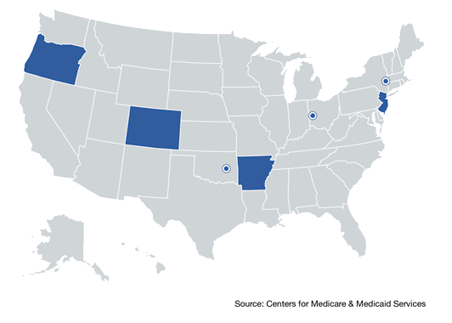
CPCi was a National Program
7 Regions from New York to Oregon
500 primary Care Clinics
72 Primary Care Clinics in Colorado

Slide 7
CPC Classic
October 2012- December 2016
Mercy Family Medicine, Durango, CO
Centura Health Physician Group (CHPG)
3 Clinics in Durango area: Mercy Family 3 Springs; Mercy Family Medicine Horse Gulch; Mercy Family Medicine Bayfield
Mercy Primary Care Clinics were the only Centura Health Physician Group (CHPG) clinics involved in CPCi
CHPG pulled the data needed for reporting on Clinical Quality Measures
Clinics did the rest keeping track of all data manually

Slide 8
What is Empanelment?
Attaching every patient to:​
Primary Care Provider and/or Care Team to promote the delivery model of the Patient Centered Medical Home​
​

Slide 9
Why Empanel our patients?
Article in Family Practice Management (1):
Makes Patients Happy and Feel Connected
Defines the Workload for Team Based Care
Predicts the Workload Demand for the Office
Improves Outcomes….
1) Panel Size: How Many Patients Can One doctor Have?, Mark Murray, MD,MPA, Mike Davies, MD, Barbara Boushon, RN,Fam Pract Manag. 2007 Apr; 14(4):44-51

Slide 10
Why Risk Stratify?
Identify who could use intensive care management

Slide 11
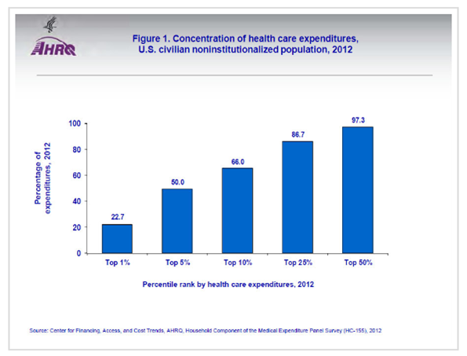
Health Care Costs
Notes:
We want to care manage the sickest patients for better outcomes.
We want to manage the sickest patients to lower healthcare costs. For example to reduce ER visits or reduction in 30 day readmission rates.
Really the triple aim: healthier patients; better outcomes; and lower costs. The Graph above, from the Agency of Healthcare Research and Quality shows us that
The top 5% of the sickest patients utilize 50% of Healthcare dollars.
Source: Center for Financing, Access, and Cost Trends; 2012
Sooooo does 20% of our Population use 80% of health are dollars, or is that just fake news??

Slide 12
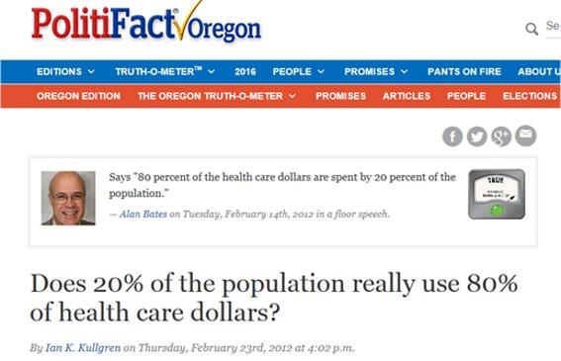
FACT CHECK

Slide 13
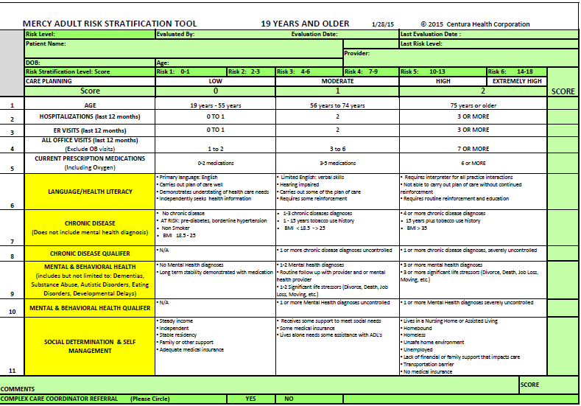
Mercy Adult Risk Stratification Tool

Slide 14
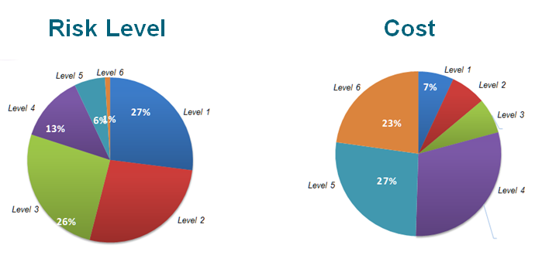
Risk Level vs Cost
Level 5 and Level 6 use 50% of Health Care Dollars
Notes:
This is an illustration of how the top 1% of the U.S. population accounts for nearly 23% of overall health care costs.
7% are responsible for a full 50% of our current health care costs. CPC+ wants clinics to tease out the top 1% and intensively care manage that population to reduce one quarter of healthcare costs. Ideally target the top 7% to cut healthcare cost in half!

Slide 15
CPCi
Positive Outcomes
Decreased Per Member Per Month (PMPM) Expenses for Medicare population (~3000 patients)
$604 PMPM, 8th lowest in the Colorado region of 75 CPCi practices.
MFM reduced Medicare expenditures by $2,592,000 annually compared to the Colorado region average.
Decreased Hospital Admissions for Any Cause (~3000 patients)
Mercy Family Medicine had a Medicare cost avoidance of $6,942,000 annually compared to the Colorado region average.
Worthy to note:
MFM also grew from 1117 (2013) Medicare patients to 2799 (2016), an 80% increase. The Colorado region clinic average grew from 446 to 664 Medicare patients, a 60% increase during the course of CPCi
Accolade
CPC Classic Colorado Clinic Champion (1 of 7 Nationally) awarded to Mercy Family Medicine in 2016

Slide 16
Success is Going From Failure to Failure Without Losing Enthusiasm
Abe Lincoln

Slide 17
Moving Forward Comprehensive Primary Care Plus

Slide 18
What is Comprehensive Primary Care Plus?
Strengthening Primary Care is critical to promoting health and reducing overall healthcare costs.
2,900 Primary Care practices; Approximately 15,000 Primary Care Providers; Over 2 million Medicare Beneficiaries
18 regions: Arkansas, Colorado, Hawaii, Greater Kansas City Region of Kansas and Missouri, Louisiana, Michigan, Montana, Nebraska, North Dakota, Greater Buffalo Region of New York, North Hudson-Capital Region of New York, New Jersey, Ohio and Northern Kentucky Region, Oklahoma, Oregon, Greater Philadelphia Region of Pennsylvania, Rhode Island, and Tennessee.
56 aligned payers
This partnership gives practices additional financial resources and flexibility to make investments, improve quality of care, and reduce the number of unnecessary services their patients receive.
Notes:
Tamra:
Slide 11
What is Comprehensive Primary Care Plus? It is a national advanced primary care medical home model the aims to strengthen primary care through multi-payer reform and care delivery transformation. That’s pretty cool! Have payers collectively pay risk stratified care management fees, up front to primary care practices to enable them the resources to improve the quality and efficiency of care, and reduce unnecessary health care utilization. This care delivery redesign ensures that practices have the infrastructure to better deliver whole person care to result in a healthier patient population. The CPC+ program is committed to practices and wants them to succeed. CPC+ provides practices with a robust learning system, as well as actionable patient-level cost and utilization data feedback, to guide their decision making. This is a great idea and it is working! Better care, lower costs, improved outcome and increased provider satisfaction by giving them additional resources. Isn’t this what we all want?
There are currently 3000 primary care practices participating in CPC+, across the nation from the East coast to the West coast. 61 payers have aligned and are committed to paying per member per month, risk stratified care management fees to primary care practices. This is allowing primary care practices to deliver the comprehensive care needed to decrease utilization.

Slide 19
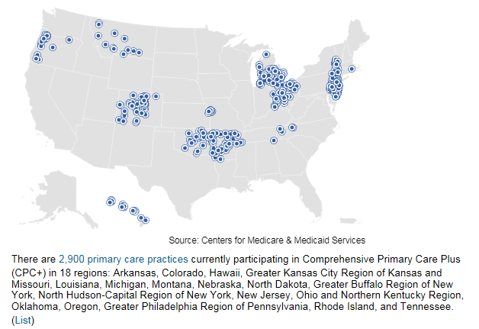
CPC+ Clinics Across the Nation

Slide 20
Definition of CPC+
Comprehensive Primary Care Plus (CPC+) is a National Advanced Primary Care Medical Home model that aims to strengthen primary care through regionally-based multi-payer payment reform and care delivery transformation
CPC+ seeks to improve quality, access, and efficiency of primary care. Practices will make changes in the way they deliver care, centered on 5 key Comprehensive Primary Care Functions:
(1) Access and Continuity (2) Care Management (3) Comprehensiveness and Coordination (4) Patient and Caregiver Engagement (5) Planned Care and Population Health

Slide 21
Why CPC+ Making Primary Care Primary

Slide 22
Achieving the Triple Aim
Starts with Primary Care; the ‘ground zero’ for healthcare reform
CPC+ is the national movement that has proven Primary Care is the foundation for Healthcare transformation to value based care which ‘Decreases Healthcare Costs, Increases Quality Care and Improves Patient Outcomes’.
Aligned payers making payments to Primary Care to build the infrastructure to allow for delivery of integrated care
Targeted Care Management of high risk patients
Care Coordination with Community Resources Across the Medical Neighborhood
Follow up for ED and Hospital visits
Integrated Behavioral Health Providers; Diabetic Educators; Pharmacists
Increase Provider satisfaction with team based care, Providers not having to “Do It All”
Improve collegiality between Primary Care Providers and Specialists with Care Compacts

Slide 23
Must have Integrated Primary Care

Slide 24
Strategies for Success
Lessons Learned
Imperative value in having a Provider Champion
Sets example and reinforces critical buy-in from providers
Advocates for the vision and action that payers are taking to pay for the value of care delivered over the volume of care delivered to sustain Primary Care practices
Essential to have Senior Leadership Commitment and Participation

Slide 25
Strategies for Success
Lessons Learned
High Value in having embedded RN Care Coordinators (RNCC) in clinics
High return on investment; improved patient outcomes; cost avoidance; improved patient satisfaction; improved provider satisfaction
Able to target high risk patients with continual collaboration with Provider/Behavioral Health Provider/Pharmacist/Diabetic Educator
Able to have warm hand offs in the clinic setting to establish relationships and develop care plans
Able to visit hospitalized patients for initial warm hand off and set up an Out Patient Visit (OPV) with their provider prior to discharge (OPV closer to discharge = better outcome and reduces 30 day re-admissions)
Able to have 1:1 discussion with patient’s provider to arrange for immediate follow-up depending on patient’s condition and risk
Able to develop close relationships with hospital Case Managers/Discharge Planners
Able to develop close collaborative relationships with community resources

Slide 26
Strategies to Consider for Success
Lessons Learned
Essential to have embedded Behavioral Health Provider (BHP)
Primary care is first line in treating behavioral health needs, people generally go to their primary care provider before a therapist
Warm Hand Offs provide the highest success rate for first-time intervention with a BHP
Private Payers are compensating for BH care management, realizing the extreme need
Medicaid is compensating for BH care management, realizing the extreme need

Slide 27
Strategies to Consider for Success
Lessons Learned
High Value in having designated RN for ED follow-up phone calls
A licensed clinical staff to discuss possible medical treatment; discuss signs and symptoms of further risk; explain medications; answer clinical questions
We hired one part-time RN, 4hrs/day 5 days a week and are able to attain 100% ED follow-ups within 3 business days in all four of our clinics
Able to re-educate our patients and encourage them to use same day visits, extended hours, and 24/7 nurse helpline

Slide 28
“It is not the strongest of the species that survives, nor the most intelligent, but the one most responsive to change”
Charles Darwin

Slide 29
Healthcare Reform Benefits of an Alternative Payment Model

Slide 30
Model for Payment Reform
CPC+ Payment Model
All Payers
Care Management Fee (CMF)
Provides a non-visit-based CMF paid per-beneficiary-per month (PBPM)
Care Management Fees are paid on all beneficiaries, from multiple payers

Slide 32
Payers with Vision
Rocky Mountain Health Plan developed a non ‘fee for service’ (FFS) payment model for Primary Care years ago and was the first private payer to have an alternative payment model to align with Medicare’s model for CPC+
At the Colorado Multi-Stakeholders Meeting (August 2018) Anthem-Blue Cross Blue Shield stated that they were ready to stop all FFS payments to Primary Care and move solely to risk adjusted PMPM payments to Primary Care clinics
Medicare model of payment demonstrated in CPC+

Slide 33
Inform Healthcare Policy in Colorado
Health First Colorado (Colorado Medicaid)
Primary Care Payment Reform Influenced by the State Innovation Model (SIM)
Starting in 2019 +4%/-4% payment adjustment according to meeting clinical quality measures
All CPC+/SIM practices automatically qualify for positive 4% payment adjustment, recognized as working toward practice transformation (All 4 Mercy Primary Care clinics are CPC+/SIM clinics)

Slide 34
Mercy Family Medicine’s Achievements Successes and Recognitions

Slide 35
MFM Showcased and Recognized
Center for Medicaid and Medicare (CMS) for Risk Stratification Tool
Mercy Adult and Pediatric Risk Stratification Tool
CPC+ National Implementation Guide 2016; 2017
National Webinar Presentations
Colorado Learning Collaborative Presentations
CPC+ Clinic Spotlight for Risk Stratification Tool (First Clinic out of 3000)
2018 National CPC+ Annual Conference Presentation
MDPCP (Maryland Primary Care Program) Learning Session presentations

Slide 36
MFM Showcased and Recognized
Centura Health Physician Group (CHPG) for Risk Stratification Tool
Mercy Adult and Pediatric Risk Stratification Tool
CHPG Holds Copyright
Built into Epic, our electronic medical record
CHPG Learning Collaborative Presentations

Slide 37
MFM Showcased and Recognized
Multiple Presentations
Risk Stratification Tool; Empanelment; Team Based Care; Clinical Quality Measures; and CPC Successes
Hospital Associations; Scottsdale Institute; Institute for Healthcare Improvement; Davies Selection Committee; Davies Recipient - HIMSS16; HIMSS17; Pod Casts; ECHO Series; YouTube*; Evidence-Based Practice Research and Innovation Conference; State Innovation Model (SIM) Learning Collaboratives; CPC Classic and CPC+ Learning Collaboratives; Maryland Primary Care Program (MDPCP)
* https://youtu.be/dl_U72zTPg4

Slide 38
Mercy Family Medicine Status Report
Mercy Family Medicine Clinics have met and exceeded all elements required for CPC+
Longitudinal Care Management by RN Care Coordinators for high risk patients ~4% of population (Goal 1%)
Integrated Behavioral Health Providers: one at 3 Springs, one at Horse Gulch, new one coming in July 2019 (SIM Grant)
Community Health Advocate: screens for ‘life’ needs like food, housing, transportation, employment, finances
Embedded Diabetic Educators
Hospital f/u within 2 business days at 93% (Goal 75%)
ED f/u within 7 days at 100% (Goal 35%)
Alternative visits: Psychiatry Telemedicine; Assisted Living Facility visits; Skilled Nursing Home Facility visits; Home Visits; Pharmacy Telemedicine; Genetic Counseling Telemedicine
Patient and Family Advisory Council (PFAC) meets 1X/mo. (Goal 2X/yr.)

Slide 39
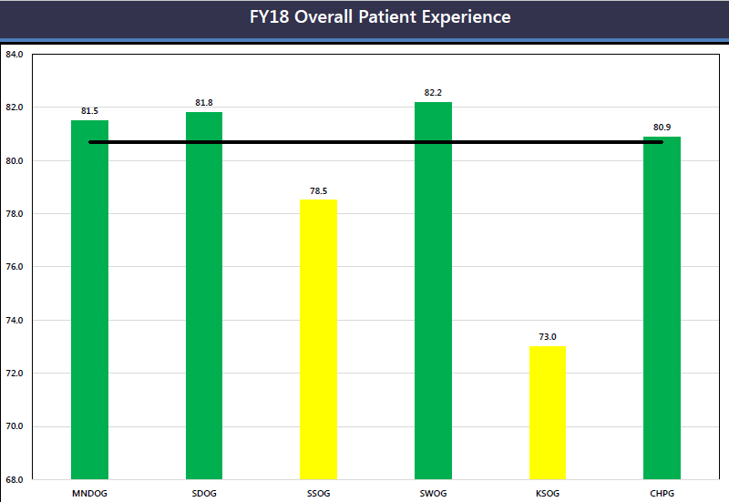

Slide 40
MFM is creating a vision that Comprehensive Primary Care is foundational in providing the physical, mental, emotional and spiritual aspects of healthcare delivery for the population we serve.

Slide 41
Thank You

