Slide 1
Southwest Colorado: NO Wrong DOOR AND network of care
What it is, How to use it and how you can be a part of it
Presented by Mattie Baker
San juan basin area agency on aging

Slide 2
What is No Wrong Door?
The first step in developing a statewide database where Long Term Services and Supports (LTSS) can be made more effective, accessible, interconnected and person-centered – for both consumers and agencies

Slide 3
What is Network of Care?
http://sanjuanbasin.co.networkofcare.org/aging/
A resource utilized by No Wrong Door pilot sites
The Network of Care provides fast and easy access to comprehensive community services, information, support, and assistance on a localized level to millions of people nationwide.
Personal/Medical Information can be stored safely, and shared with consumer permission only through a HIPPA compliant secured page

Slide 4
A Few of the Highlights…
Library of Information
Legislation
Additional Resources
Fact Sheets and Reports
Interactive tools
Information on medications and symptoms
Other Resources
State and Federal Bills
Tools to Communicate
Assistance with Voter Registration
Links
Detailed information on more than 21,000 assistive devices
“My PHR”

Slide 5
Network of Care: Searching for Resources

Slide 6
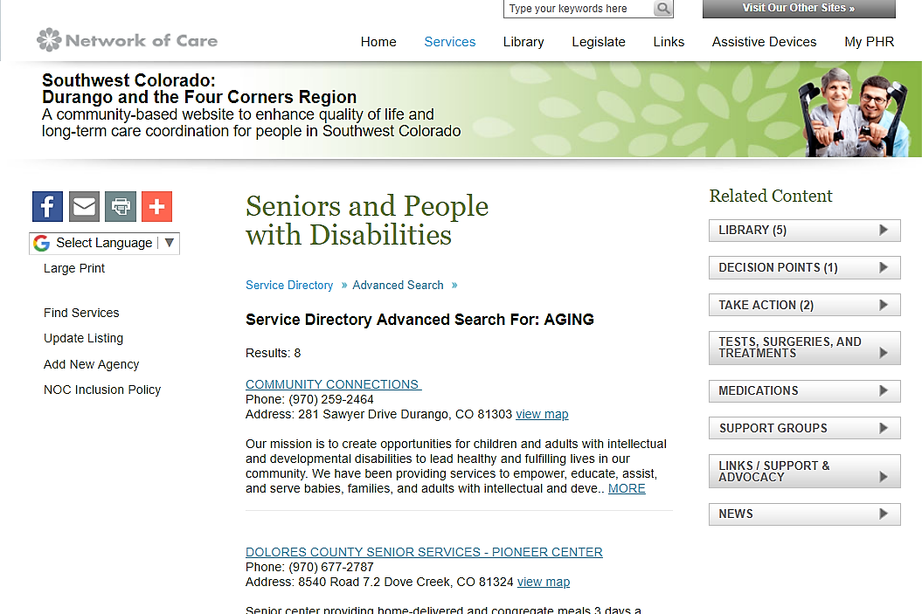

Slide 7
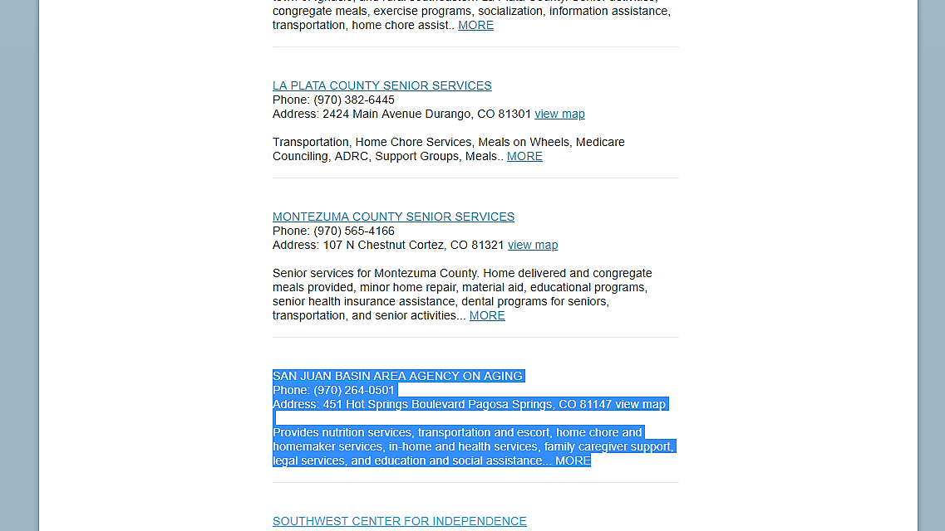

Slide 8
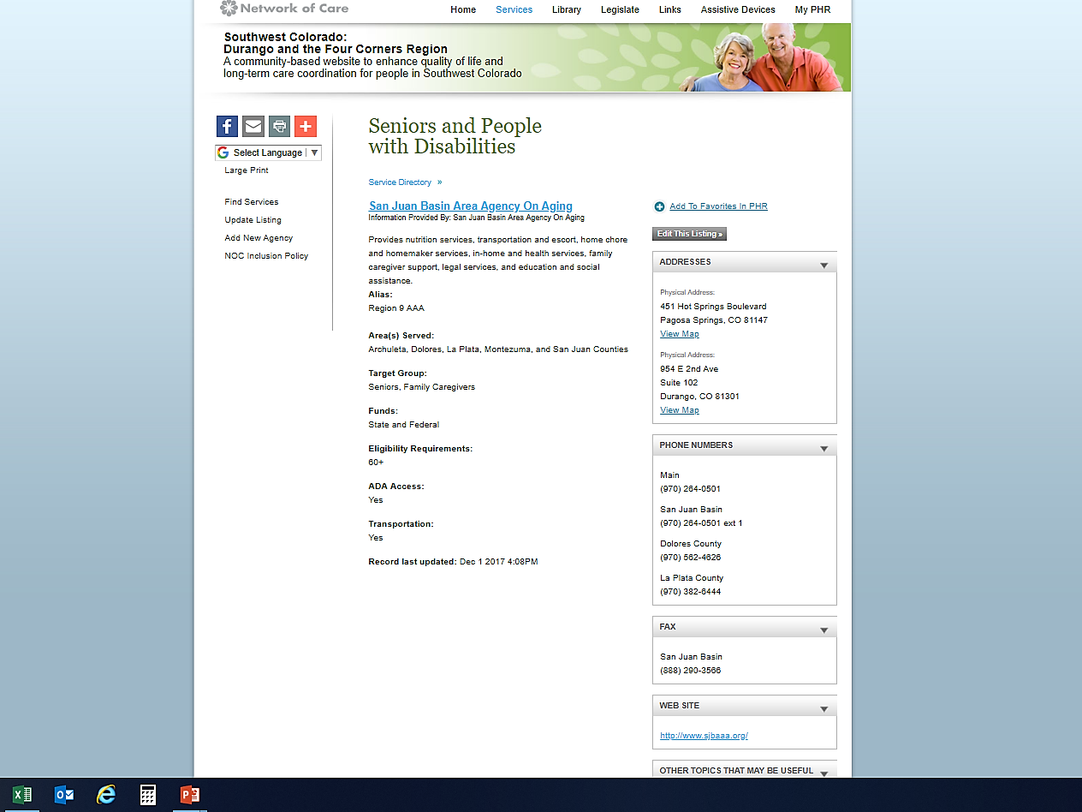

Slide 9
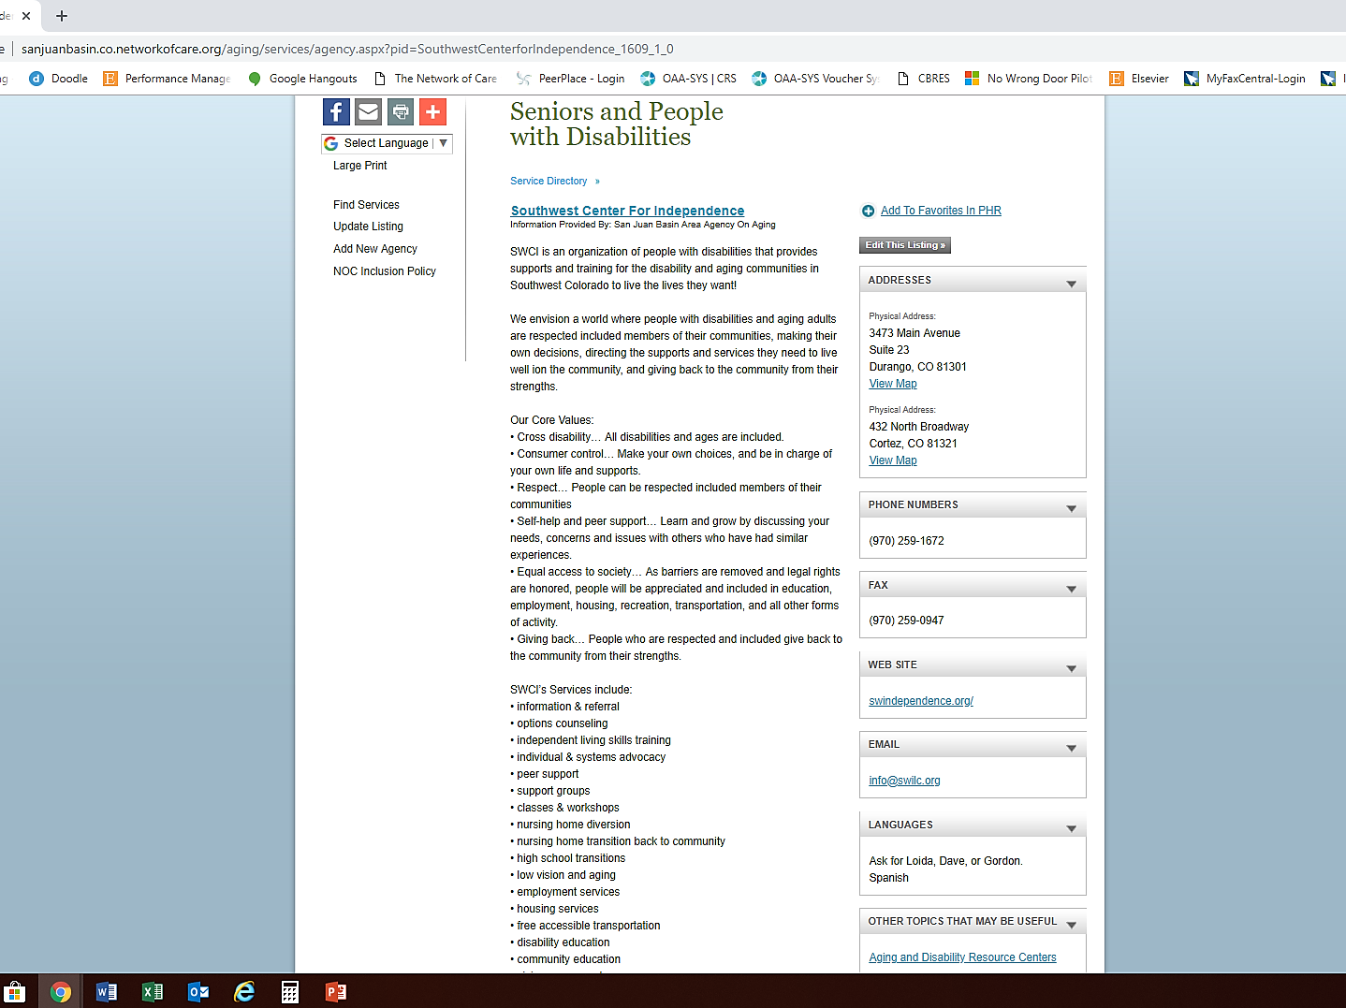

Slide 10
Benefits of Adding Your Agency to Network of Care
Free!
Easy!
Accessible!
Thanks to funding provided by the No Wrong Door grant, Network of Care is currently free to join and free to use!
Network of Care is full of information and resources without being overwhelming.
Make your organization more visible and easy to access by more people…for free!

Slide 11
How to Add Your Agency to Network of Care
Visit sanjuanbasin.co.networkofcare.org/aging
Select ‘Services’ tab
Click-’Add New Agency’-Input information-Submit for approval
OR
Sign up for a 15 minute phone call and I will help you with the process
That’s it! So easy!

Slide 12
Want More Information?
Please sign up for a phone call or contact me anytime:
Mattie Baker
Program Manager/NWD Lead
970.264.0501 ext. 4
program.manager@sjbaaa.org

