Slide 1
TLC: Group Theraplay in the classroom
What is the first thing that comes to mind when you hear “Mental Health” ?

Slide 2
Mental Health vs Mental Illness
Mental Health: Having emotions, positive and negative and the ability to express them in appropriate ways.
Mental Illness: Viewed as more fatalistic. It is genetic. Immune to treatment

Slide 3
Trauma
deeply distressing or disturbing experience
Emotional shock following a stressful event or a physical injury, which may be associated with physical shock and sometimes leads to long-term neurosis
An emotional wound or shock

Slide 4
TLC: What is it?
TLC is a method of enhancing
Attachment
Engagement
Self-esteem
Trust in others
Based on the natural patterns of Healthy interactions
We all need to keep it personal, engaging, and fun!

Slide 5
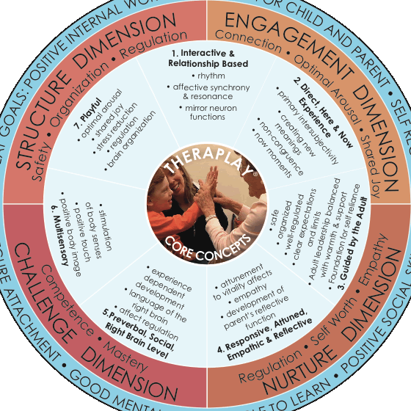
TLC

Slide 6
Engagement Dimension
Connection
Enthusiasm
Shared Joy

Slide 7
Structure Dimension
Safety
Organization
Regulation

Slide 8
Challenge Dimension
Competence
Mastery

Slide 9
Nurture Dimension
Regulation
Self Worth
Empathy

Slide 10
The foundation of the Theraplay experience: Core Concepts
Interactive and Relationship Based
Direct Here and Now Experience
Guided by the adult
Responsive, Attuned, & Empathic
Preverbal/Social/Right Brain level
Multisensory
PLAYFUL

Slide 11
Basic assumptions
Positive interactions result in child”s inner representation (Inner Working Model)
Self as loveable, special, competent
Others as loving, responsive, trusting
World as a safe exciting place

Slide 12
Basic Assumptions
The idea of self and their personality develop out of the early parent child interaction.
But “WHAT IF????
When there is an unhealthy parent/ child interaction a child's internal working model is upset

Slide 13
Basic Assumptions….
Negative interactions result in child’s inner representation (IWM)
Self as unlovable and incompetent
Others as uncaring and untrustworthy
World as unsafe and full of threats

Slide 14
Internal Working Model
Implicit view of self and others
Organized strategy for maintaining safety and comfort under stress
Laid down as neural pathways
Stable but can be changed by new experiences

Slide 15
Basic Assumption
Caregiver empathy and sensitivity are essential to the child’s healthy development and secure attachment.
Early experience of co-regulation are the basis for later emotional self regulation.

Slide 16
Goal of Group Theraplay
Create (or fine tune) a secure, attuned, joyful relationship between a child and her /his teachers

Slide 17
The Results…
Positive changes in child’s IWM
Better self regulation
Reduction of relationship and behavior problems
Positive outcomes associated with secure attachment: Better social skills, better school performance, and more competence and long term mental health!!!!!

