Slide 1


Slide 2
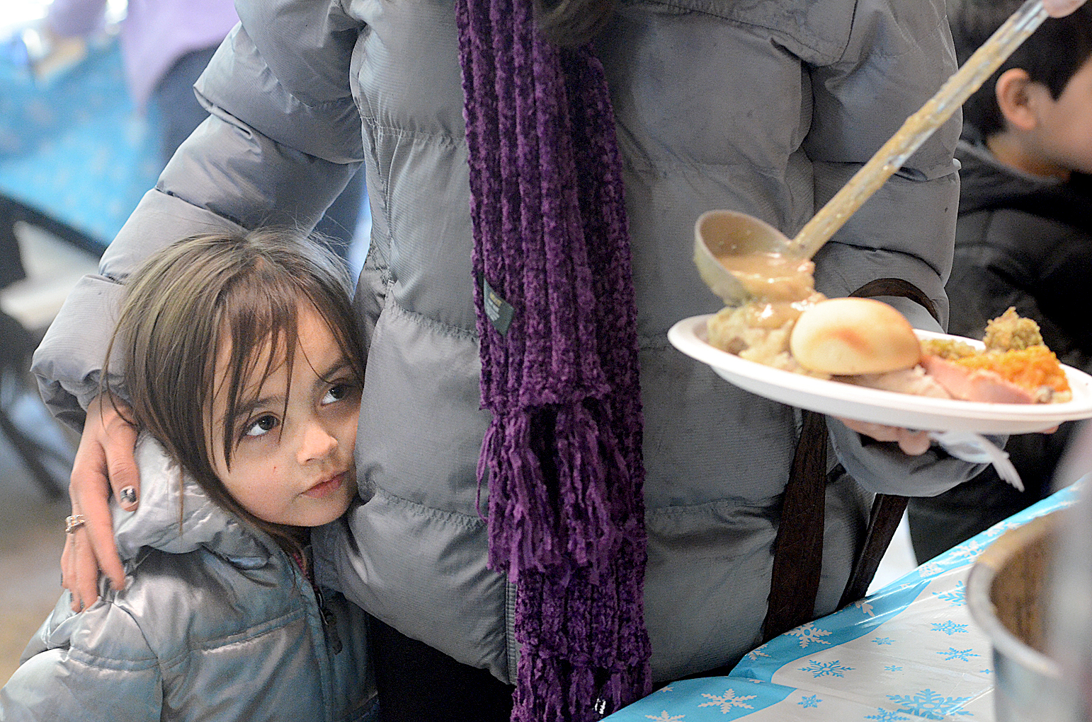
Mission Statement
The mission of Manna is to provide, in the spirit of faith and love, nourishing meals and supportive services in an atmosphere of acceptance and caring for those in need.
Steve Lewis/Durango Herald

Slide 3
The History of Manna
Manna Soup Kitchen was founded in May, 1985. The previous winter, a woman died from starvation in a horse stall at the La Plata County Fairgrounds in Durango, Colorado. Scrawled on the wall beside her were the words, “nobody cares.” This tragedy resulted in a small group of Christians organizing to provide food assistance for the hungry.

Slide 4


In 2017 Manna…
Served 64,323 meals to the food insecure population
Received over 124,000 lbs. in donations from community donors
Volunteers accounted for 10,812 hours of service
Client Services provided 4,216 vouchers including: bus passes, food bank referrals, thrift store vouchers, hair cuts, and prescription coverage

Slide 5
Manna’s Services
Open 7 days/week to provide meals to the food insecure
Shower and laundry facilities
Manna Culinary Program
Backpack Program: Durango School District 9-R & Southern Ute Boys and Girls Club
Internship Program
Client Services
Emergency Food Boxes
Local food distribution: Grub Hub at Fort Lewis, Southwest Safehouse, Durango Community Shelter, Hilltop House, Durango Food Bank

Slide 6
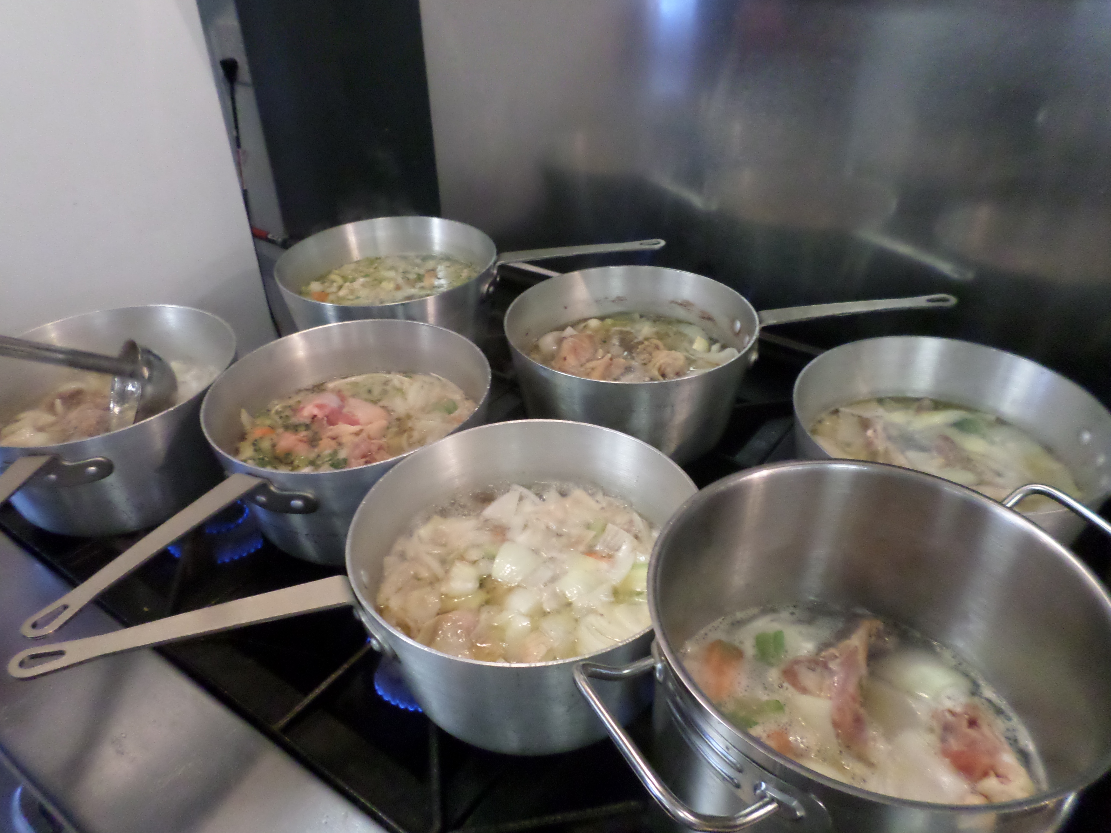
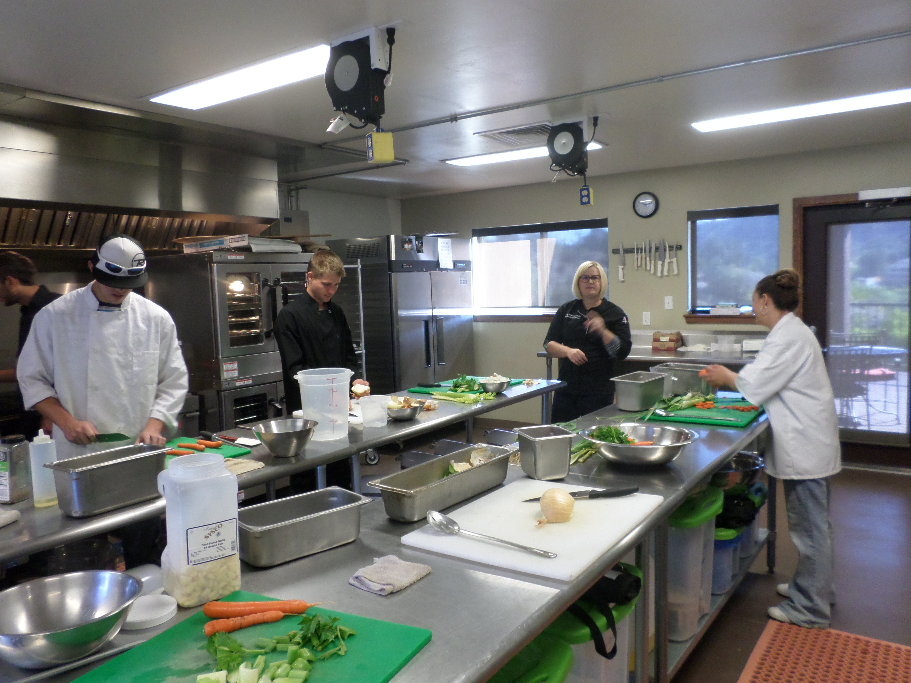
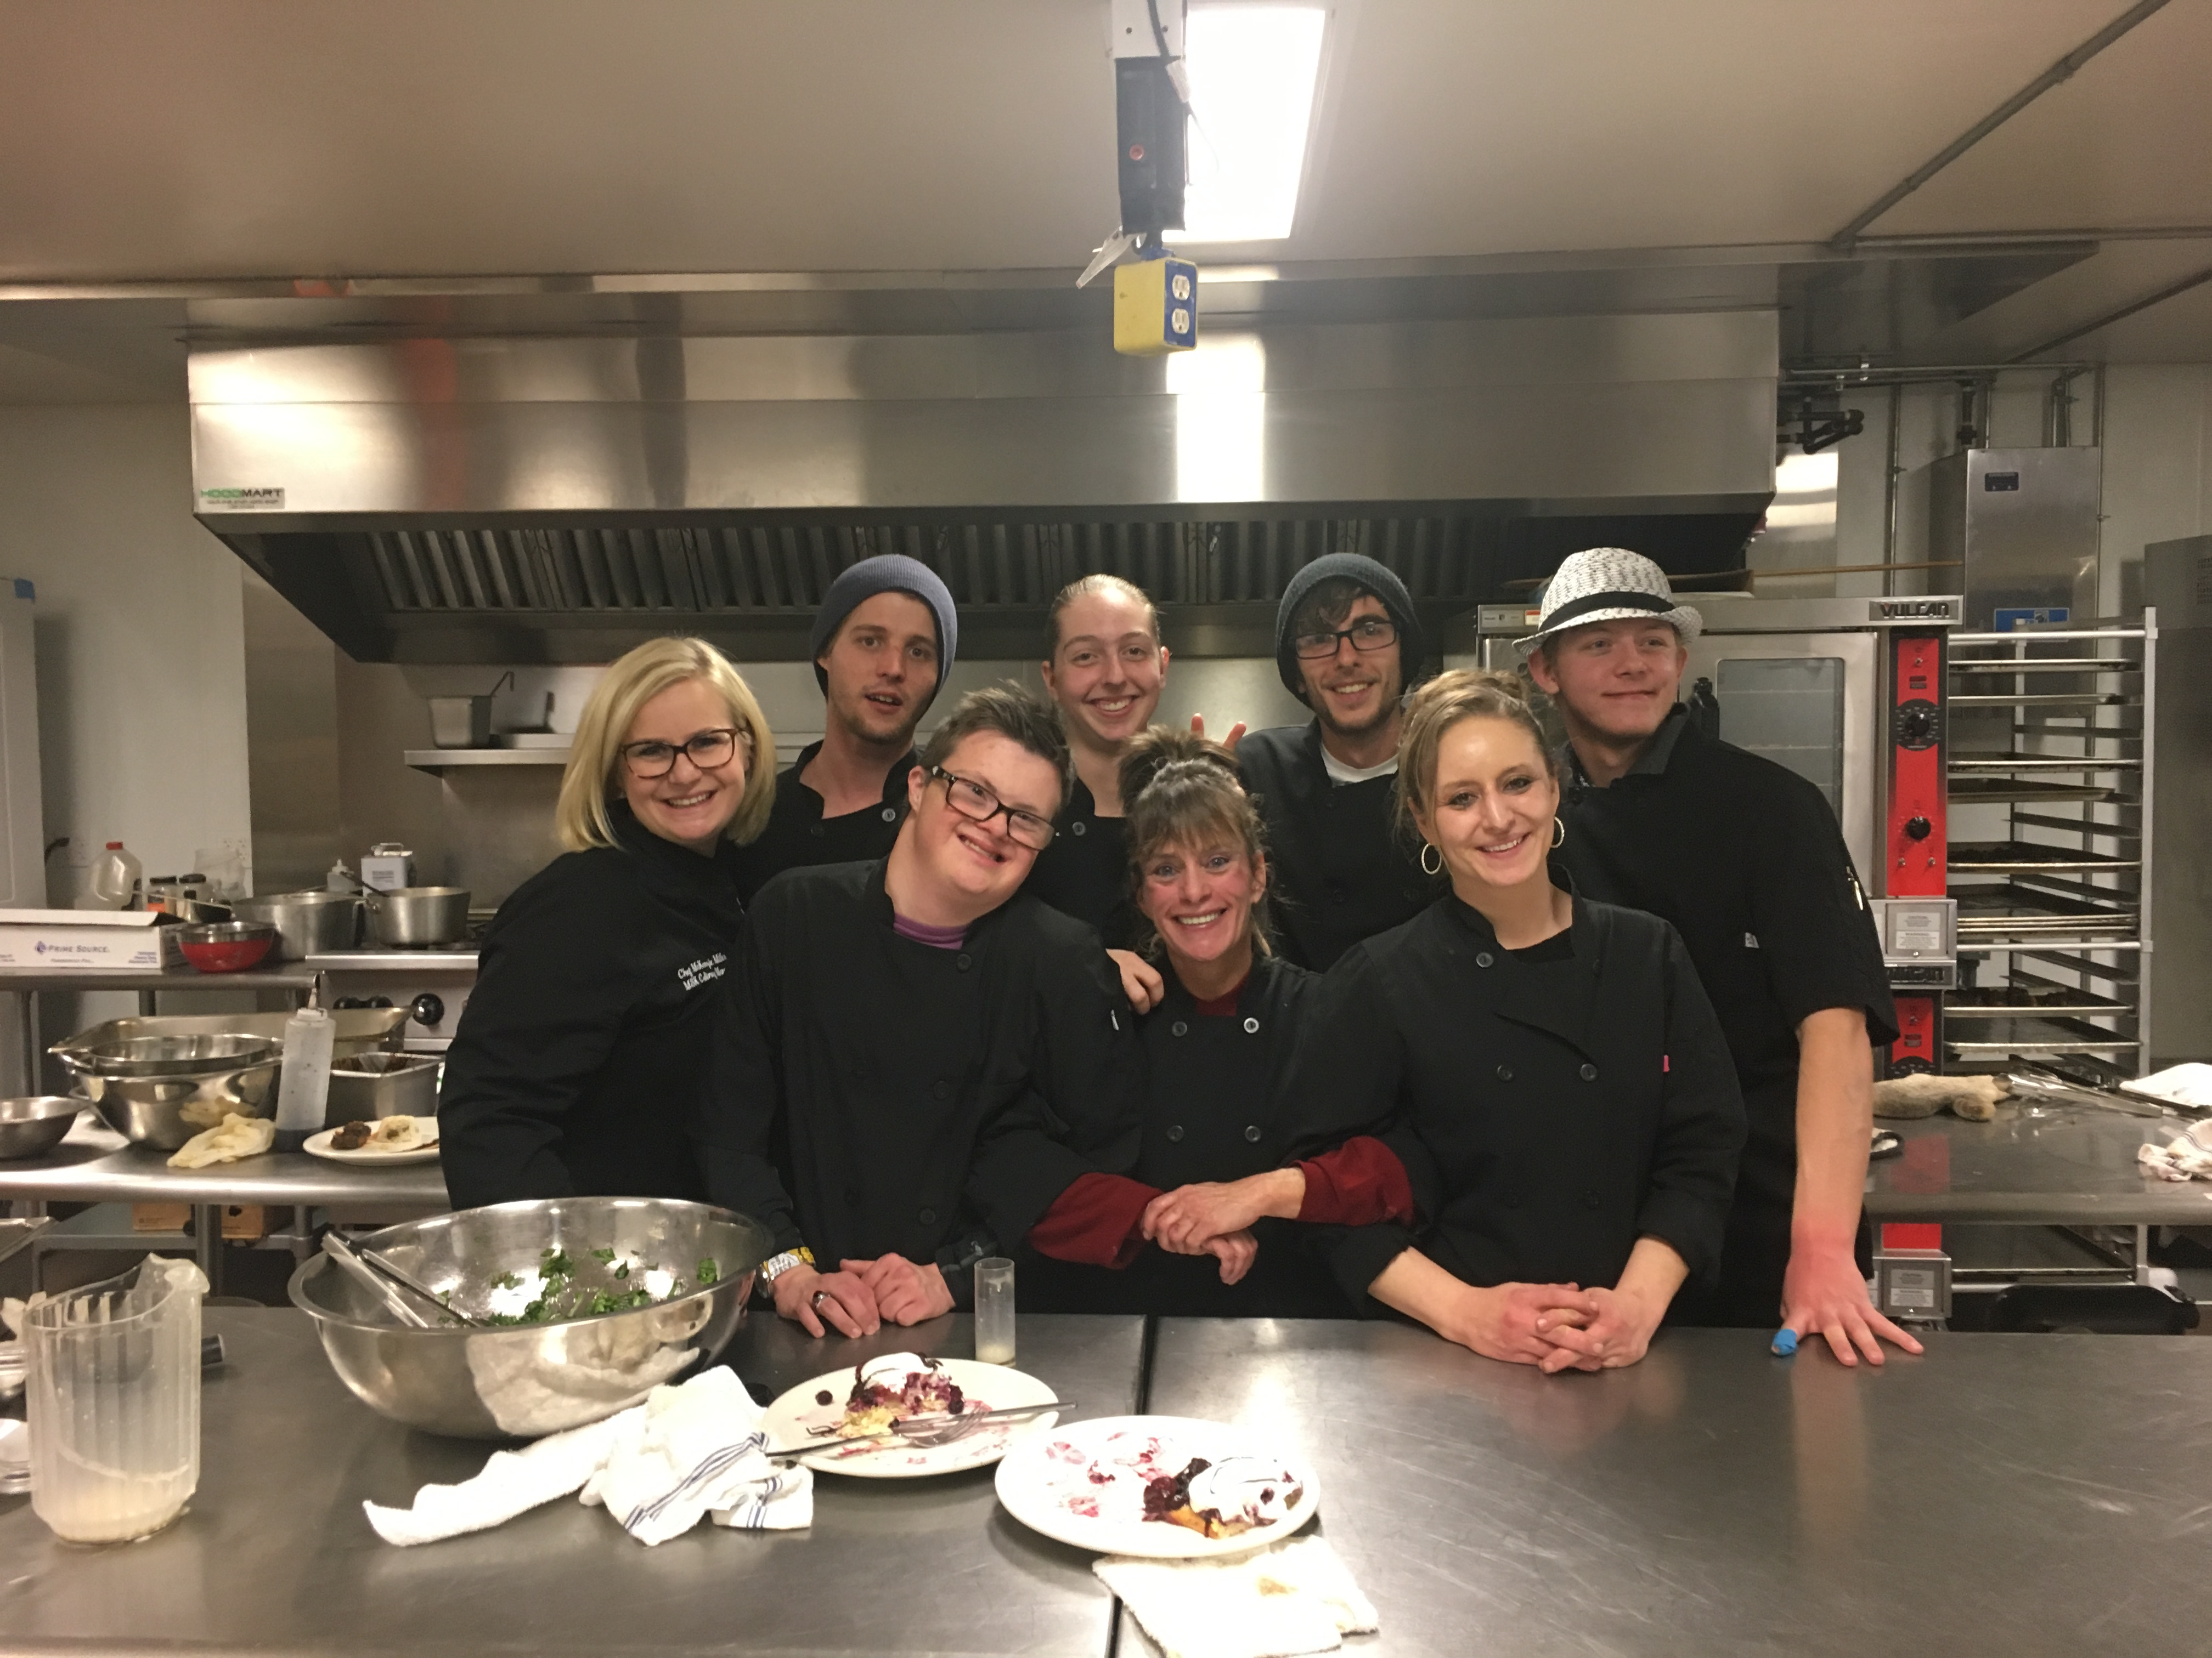
Culinary Program
10 Week Program
Students complete internships at local establishments
Classes taught with the help of chefs from local restaurants
Students receive a two-year state-recognized Food Handlers Certificate, and a certificate of completion
40 completions through 2017 - 80% of graduates currently employed in food service industry

Slide 7
Events and Fundraising
Bread For Manna – September 29, 2018
The Durango Voice – March and April 2019
No-Go Gala – December 3, 2018
Quarterly Newsletters – September 4, 2018

Slide 8
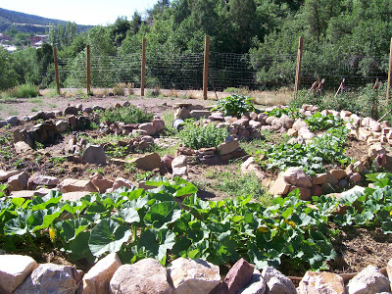

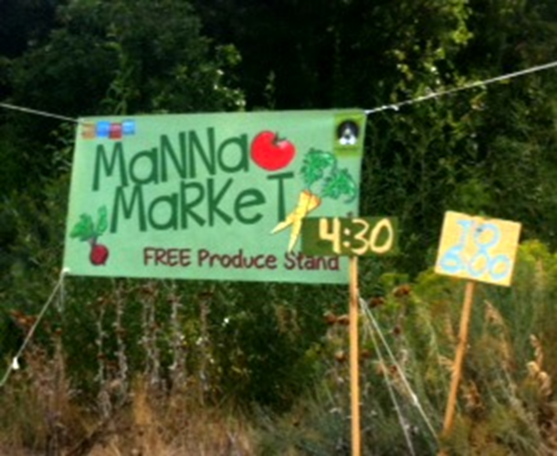
Manna Garden
Collaboration with The Garden Project of Southwest Colorado
Garden produced 1550 lbs. of produce in 2017
Wednesday evening Manna Market produce stand provides free produce to families (50 community members per week and 5,000 lbs. produce distributed in 2017)
Volunteers at the Manna Garden completed over 1300 hours of community service

Slide 9
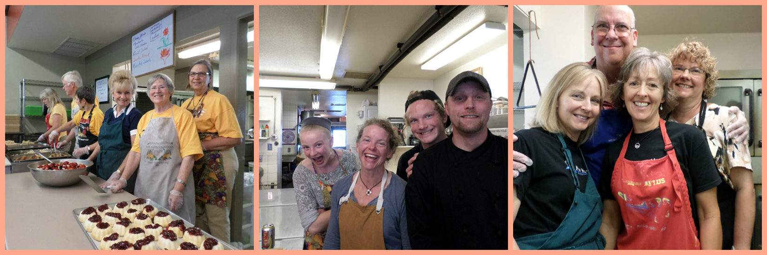
Ways to get involved at Manna
Volunteers at Manna have various ways to get involved:
Help cook, prepare, serve meals, and clean-up
Assist in food pick ups from various establishments in the community
Donate nonperishable food, warm clothing, toiletries, and other items

Slide 10
Contact Us
www.mannasoupkitchen.org
1100 Avenida Del Sol
PO Box 1196
Durango, CO 81302
970.385.5095

