Slide 1
OUR MISSION
Axis Health System will make a meaningful difference in the health of Southwest Colorado residents by integrating all aspects of healthcare and treating the whole person.
Montezuma, Dolores, La Plata, Archuleta, San Juan Counties

Slide 2
Axis Health System
Detox Unit
An innovative healthcare system that provides a continuum of health services
Senior Reach
Brief (up to 24-hour) residential withdrawal management
Support for older adults in La Plata County, including referrals and counseling
OUR AREAS OF FOCUS
Jail-Based Services
Primary care
Substance-use treatment during incarceration with referral and linkage at discharge
Care coordination
Behavioral healthcare
Housing, transportation, referral, vocational support, and health insurance enrollment assistance
Substance use treatment
Oral healthcare
Treatment, DUI education and withdrawal management
Acute Treatment Unit
Crisis care
School-Based Healthcare
Short-term, residential crisis stabilization services
24/7 Crisis Care with a mobile response team for the five counties in Southwest Colorado
Healthcare on site at two La Plata County schools in partnership with Durango School District 9-R
Healthy lifestyle support
Mental Health First Aid
Nutrition counseling and diabetes education
Skill-building classes on how to identify, understand and respond to behavioral health issues
Oral Healthcare
Dental care and oral hygiene for the whole family
Crisis Intervention Teams
Psychiatric care
Partnership with local law enforcement teaching skills to prevent and de-escalate crisis situations
Psychiatric care, including medication management
Therapy
Family, group and individual counseling services for all ages
Primary care
Whole person care including wellness, chronic illness management and immunizations
Rooted in community. Your health…We’re in this together.
The care you need to help you get well and stay well.
AXIShealth.org

Slide 3
CONTINUUM OF CARE
An integrated system of health care that follows a patient through time or through a range of services.
The goal is to offer more comprehensive patient treatment that cares for the whole person.

Slide 4
How does the integrated healthcare model work?
What is team-based care?
What is the person-centered approach?

Slide 5
Outcome-Driven Measures
Screenings include:
PHQ-9 (Patient Health Questionnaire)
AUDIT (Alcohol Use Disorders Identification Test)
HRQOL (Health-Related Quality of Life)
Body Mass Index
Blood Pressure
Why are these important to patient care?
To track progress and changes in response to treatment provided.
To adjust treatment interventions that meet patients where they are.
To provide information to patients about their care.

Slide 6
Outpatient Behavioral Health Services in La Plata County
Mental Health Outpatient
Substance Use Disorders
Jail Based Health Services
Jail Transitions
Senior Reach
Vocational Rehabilitation Services
Integrated Healthcare @ La Plata Integrated Healthcare
School-Based Health Centers
School Mental Health Specialist

Slide 7
EVIDENCE-BASED PROGRAMMING
Dialectical Behavior Therapy
Trauma-Focused CBT
Motivational Interviewing
Integrated Dual Disorder Treatment
Strategies for Self-Improvement and Change

Slide 8
Adolescent Substance Use Disorders: Marijuana Brief Intervention Matrix Model (CBT) Zero Suicide Initiative: Collaborative Assessment & Management of Suicidality Applied Suicide Intervention Skills Training
New Program Directions

Slide 9
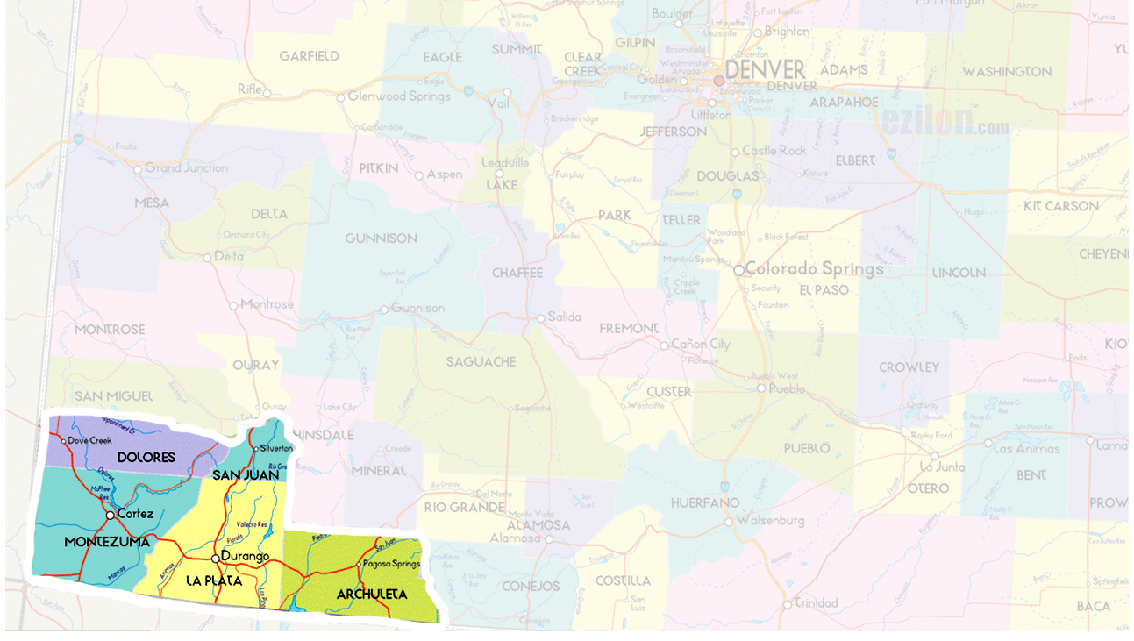
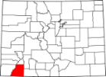
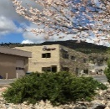
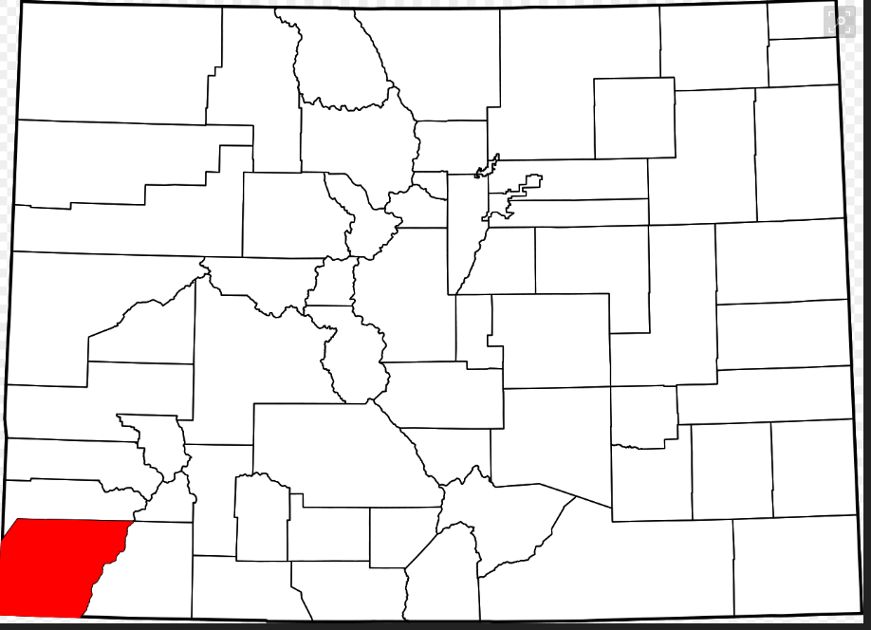
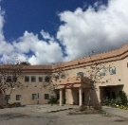
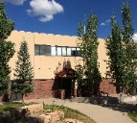
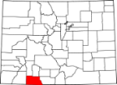
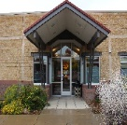
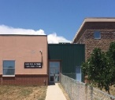
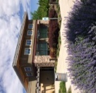
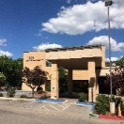
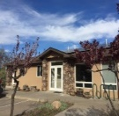
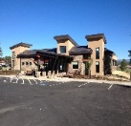
Axis Health System
In FY 2017, we served 9,442 patients in five counties across Southwest Colorado.
OUR LOCATIONS
La Plata County
Corporate Office
185 SUTTLE ST., DURANGO
Administrative offices
5,300+ patients served
Montezuma County
2,400+ patients served
Columbine Behavioral Healthcare
School-Based Integrated Healthcare at Durango High School
281 SAWYER DRIVE, SUITE 100, DURANGO
Community Mental Health Center provides mental health and substance use treatment
2390 MAIN AVENUE, DURANGO
Clinic located on site at school for
La Plata County students
Archuleta County
600+ patients served
1,000+ patients served in Dolores, San Juan & other counties.
Crossroads at Grandview
School-Based Integrated Healthcare at Florida Mesa Elementary School
1125 THREE SPRINGS BLVD., DURANGO
Acute Treatment Unit, Detox Unit and Regional Crisis response
216 HIGHWAY 172, DURANGO
Clinic located on site at school for
La Plata County students
Cortez Integrated Healthcare
La Plata Integrated Healthcare
691 EAST EMPIRE STREET, CORTEZ
Community Health Center providing primary care, behavioral healthcare and oral healthcare referrals
1970 EAST THIRD AVE., DURANGO
Community Health Center providing primary care, behavioral healthcare, oral hygiene and oral health referrals
Axis Health System Oral Health Clinic
2530 COLORADO AVENUE, SUITE A, DURANGO
Community Health Center providing preventive and restorative oral healthcare
Archuleta Integrated Healthcare
52 VILLAGE DRIVE, PAGOSA SPRINGS
Offering primary care, behavioral healthcare and oral healthcare referrals

