Slide 1
What Can We Learn About Collaboration in “Most-Improved” Communities?
Douglas McCarthy
Senior Research Director, The Commonwealth Fund
Community Health Action Coalition: April 13, 2018

Slide 2
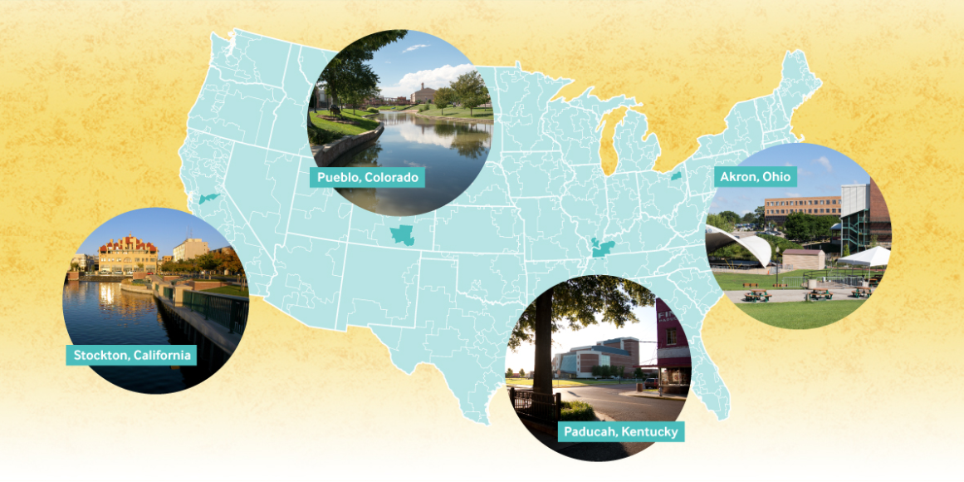
Citizens Health Action Coalition, April 13, 2018

Slide 3
Common Performance Drivers
Local governments act as catalysts for change
Health care and other community organizations cooperate to achieve common goals
Data often guides action
Local health system improvement benefits from Medicaid expansion and other investments
CHAC, April 13, 2018

Slide 4
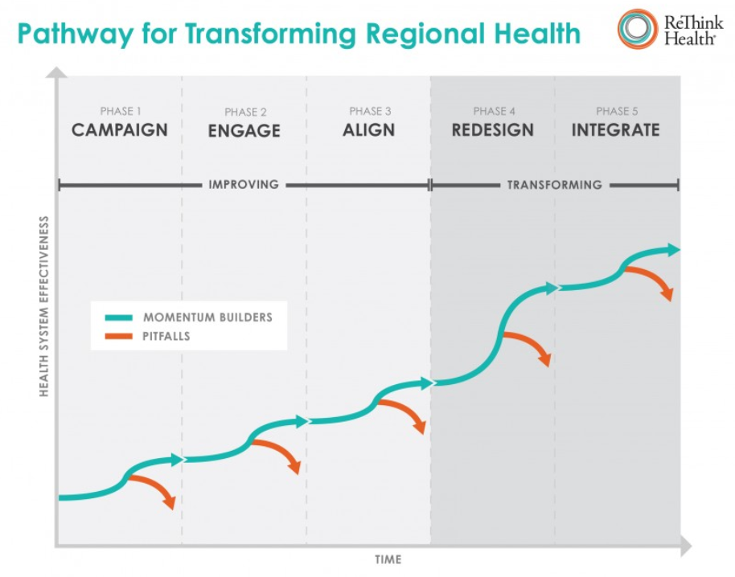
https://www.rethinkhealth.org/tools/stewardship-guide/

Slide 5
“Patient
Urgency”
Collaboration
Social Capital
Perseverance
CHAC, April 13, 2018

Slide 6
www.commonwealthfund.org dm@cmwf.org
For more information:
“All Health Care is Local, Revisited:
What Does it Take to Improve?”
CHAC, April 13, 2018

