Slide 1
The Basics
13 Principals of Effective Substance Use Disorder Treatment
Presented by
Erik Foss, LPC, LAC
Peaceful Spirit Treatment Center

Slide 2
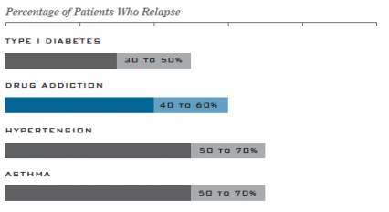
Substance Use Disorders are Complex but Treatable…..
Substance Use Disorders are defined as a chronic, relapsing brain disease that is characterized by compulsive drug seeking and use, despite harmful consequences.
In 2014 21.5 million Americans 12 and over had a substance use disorder (8.1%); 2.6 million drugs only, 4.5 drugs and alcohol, 14.4 alcohol only.
Treatment of substance use disorders is effective and shows similar relapse rates as other chronic health conditions such as diabetes, hypertension, and asthma.

Slide 3
No Single Treatment is Appropriate for Everyone
Assessment is key!
Intervention must be based on factors including:
Substance of abuse
Impact of use and/or continued use
Frequency and duration of use
Treatment history and response
Psychosocial factors of the person seeking treatment

Slide 4
Treatment Needs to be Readily Available
The earlier treatment can be offered in the disease cycle the better.
The sooner treatment can be offered from date of first contact the better.
These themes are true for any chronic health condition and also apply to the treatment of substance use disorders.

Slide 5
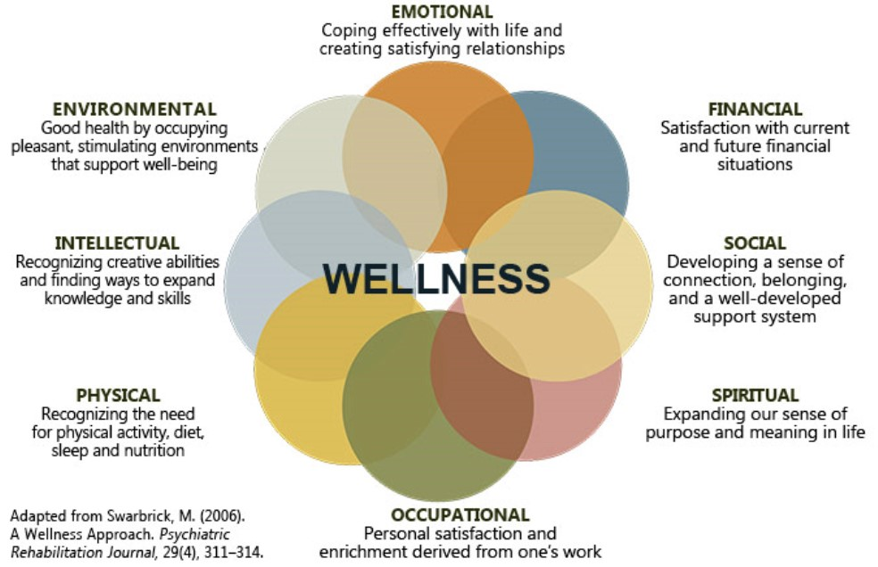
Effective Treatment Attends to Multiple Domains

Slide 6
Duration and Engagement are Critical
Research suggests a minimum of 90 days of intervention and “clean” time improves outcomes.
Treatment and the change process is an endurance race not a sprint.
Effective programs and/or interventions monitor client engagement and adjust to reduce client attrition.

Slide 7
Behavioral Therapies and Interventions
Are effective and the most commonly used treatments.
Can be delivered in a group, individual, or peer based formats.
Effective interventions are evidence based and focus on:
Clients motivation
Building incentive for stopping use/maintaining changes
Development of skills
Building a life worth living

Slide 8
Medications can help
When combined with counseling and other behavioral therapy.
They are not recommended as a stand alone treatment intervention.
Let’s change the stigma!!!!!!
Medication Assisted Treatment (MAT) is not substituting one drug for another.
MAT is the GOLD standard of care for addressing Opiate use disorders. A growing body of research is showing a reduction in Opiate use and a reduction in overdose deaths for clients in engaged in MAT.
MAT is showing promise for other substance use disorders including alcohol and stimulants.
For years MAT has been a commonly accepted intervention for addressing nicotine use.

Slide 9
Treatment is always evolving…
On going assessment is a quality of effective treatment.
Services and service delivery must change throughout the life cycle of the treatment episode.
Different domains will have different levels of emphasis throughout the care episode.
Ideally treatment is a graduated or “stepped” process.

Slide 10
Substance use and Mental Health go hand in hand
Research indicates that 60% - 70% of people with a Substance Use Disorder also have a Co-Occurring Mental Health Disorder.
Assessing for and addressing both is essential for positive outcomes.

Slide 11
Detoxification, the first step…
Managing Acute Withdrawal symptoms is essential and sometimes requires medical intervention.
Detoxification can be a long lasting process lasting days and weeks and is impacted many factors.
Only taking this step seems to have little to no impact on lasting behavioral change.

Slide 12
Voluntary versus Mandated Treatment
How many counselors does it take to change a light bulb?
Research has shown over and over that success rates for treatment is not dependent upon voluntary status. Meaning that that there is not a statistically meaningful difference related to outcomes for those clients who voluntarily seek treatment and those who are mandated to treatment.
The approach and clinical interventions for these two groups may look different; especially in the beginning.

Slide 13
Monitoring potential drug use during treatment
This can make all the difference.
It increases accountability and facilitates open dialog.
It allow for faster identification of challenges and adjustments to service delivery.

Slide 14
Testing for Infectious Diseases
Treatment is about improving a persons health.
The nature of substance use and the associated lifestyle places people at a higher risk of infectious diseases such HIV, hepatitis B and C, tuberculosis, and sexually transmitted diseases.
Testing, education, and counseling around these concerns can greatly reduce risk, improve outcomes, and extend people life span.

Slide 15
Questions? and Thank You

Slide 16
References
Festinger, D. S., Lamb, R., Marlowe, D. B., & Kirby, K. C. (2002). From Telephone to Office: Intake Attendance as a Function of Appointment Delay [Abstract]. Addictive Behaviors , 27(1). Retrieved February 5, 2018, from https://www.sciencedirect.com/science/article/pii/S0306460301001721
“NIH- National Institute on Drug Abuse.” Principles of Effective Treatment. Retrieved February 06, 2018, from https://www.drugabuse.gov/publications/principles-drug-addiction-treatment-research-based-guide-third-edition/principles-effective-treatment
“SAMHSA - Substance Abuse and Mental Health Services Administration.” SAMHSA - Substance Abuse and Mental Health Services Administration, 6 Feb. 2018, www.samhsa.gov/.
.

