Slide 1
Need more information?
Email RHConnectors@coloradohealthinstitute.org
Online www.coloradohealthinstitute.org/colorado-regional-health-connectors
The Project described was supported by Funding Opportunity Number CMS -1G1-14-001 from the US Department of Health and Human Services (HHS), Centers for Medicare and Medicaid Services (CMS) and by contract/grant number 1R18HS023904-01 from the Agency for Healthcare Research and Quality (AHRQ), U.S. Department of Health and Human Services (HHS). Opinions expressed in this document are those of the authors and do not reflect the official position of AHRQ, CMS, or HHS.

Slide 4
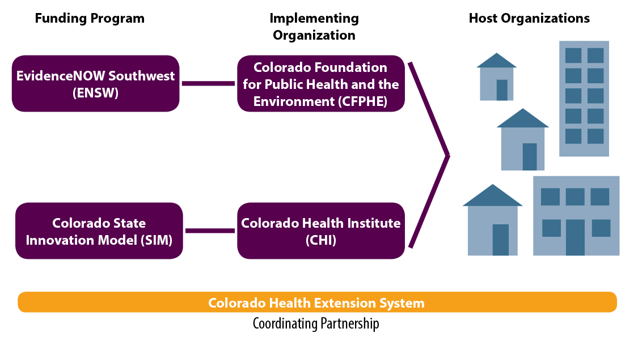
Program Structure & Administration
Notes:
After 5 years of planning, we are finally getting to implementation through the Trailhead Institute (formerly CFPH) and CHI

Slide 6
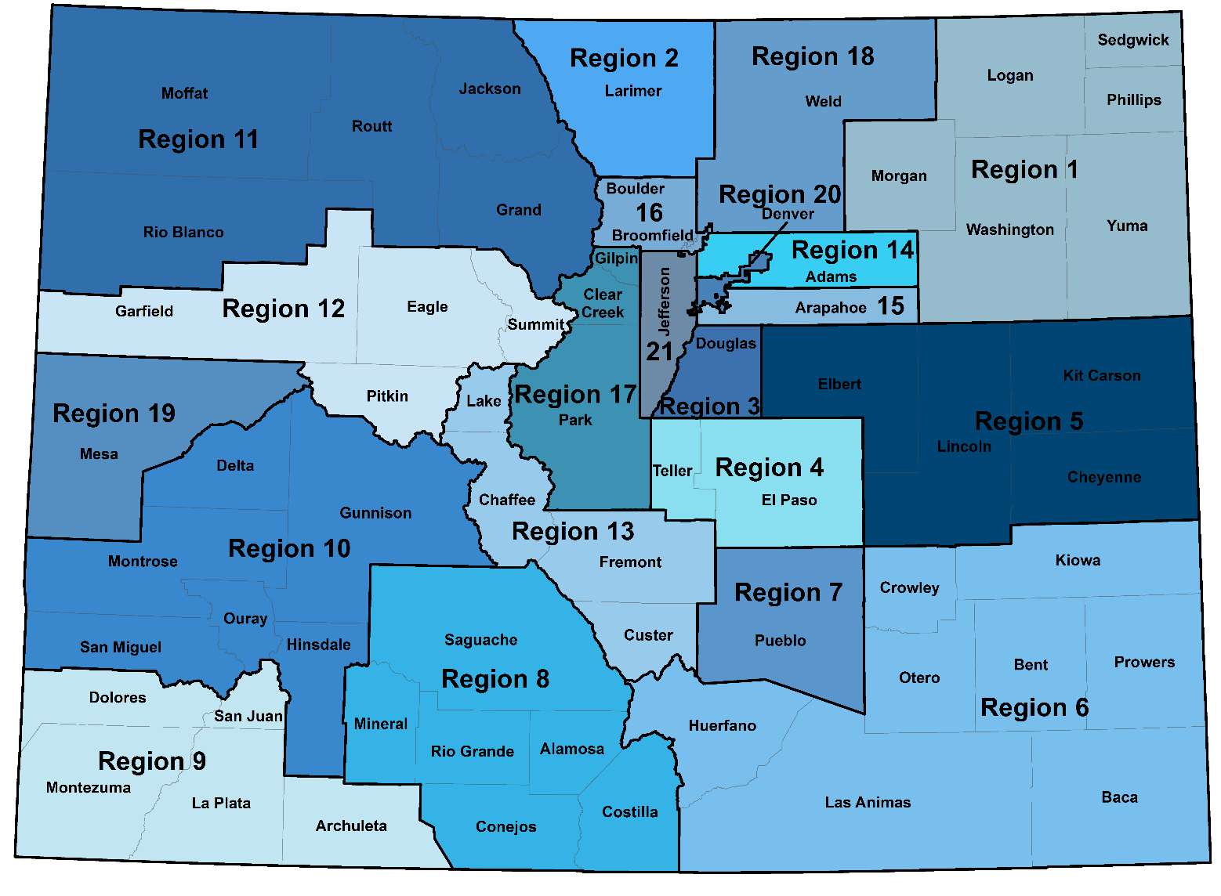

Slide 7
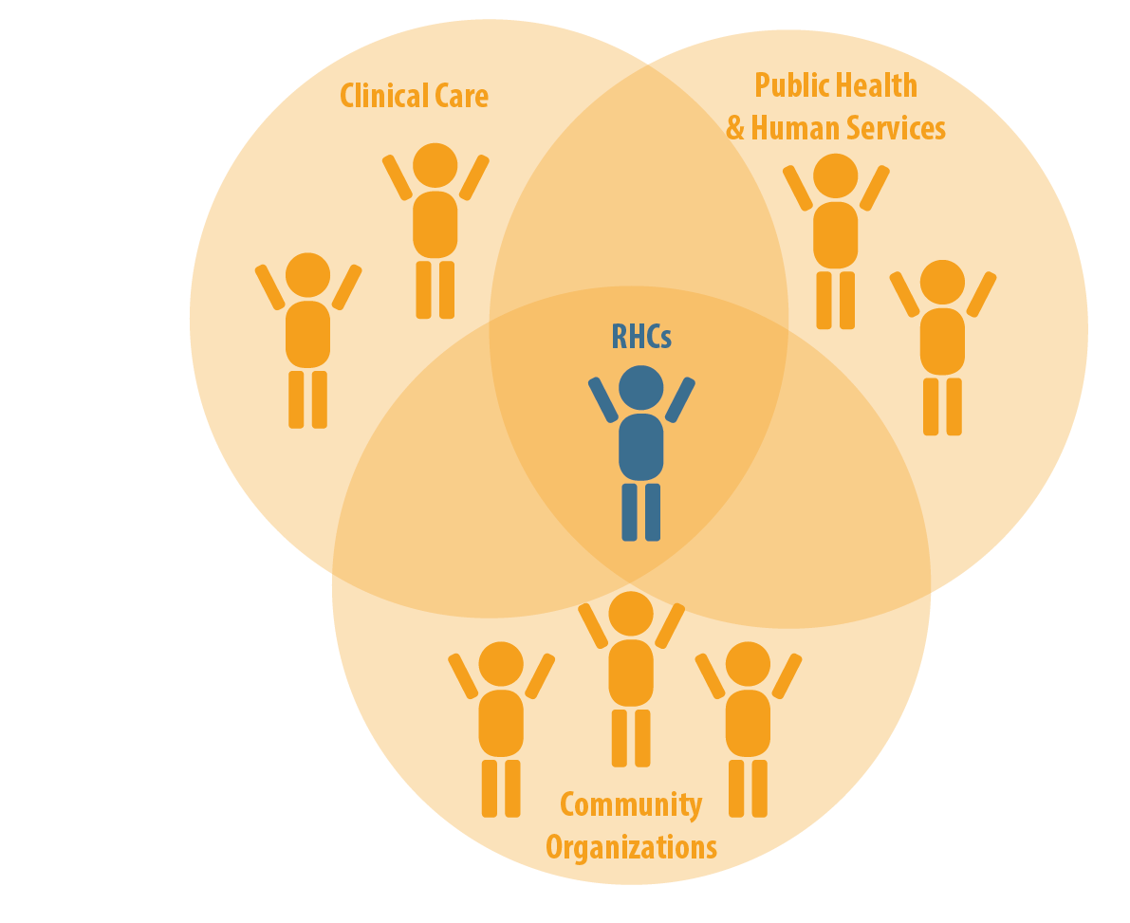
Notes:
Rebecca
Another visual of how does the RHC repair the fractured system? They build, coordinate and strengthen partnerships. Highlight the RHCs responsibility to build trust in these connections.
We've heard a lot about building partnerships and all the work and time it takes to move these efforts forward. The RHCs role is to help identify the early adopters and the existing partnerships, then connect those so that we can keep moving forward. They help facilitate or strengthen these relationships and then can step away to ensure a relationship is maintained after the RHC dollars are gone.
RHCs are dedicated to facilitating the connections that put the motion in place for truly integrated care that meets the needs of payment reform and includes improved Quadruple Aim.

Slide 8
The RHC work

Slide 9
Practice Transformation

Slide 10
Projects: Three Priority Areas
Suicide Prevention
Diabetes Reduction
Opioid Abuse Reduction

Slide 11
Project 1: Suicide Prevention
Summit Event
Town Hall Stakeholder meetings
Resilient Youth Event
Community Trainings

Slide 13
Summit Event
November 15th
5:30-7:30 pm

Slide 14
Project 2: Diabetes Reduction
Motivational Interviewing Trainings
Food Rx Project

Slide 17
Project 3: Opioid Abuse Reduction
Promote the use of the Prescription Drug Monitoring Program (PDMP)
Trainings for providers
Trainings for community
Work with AmeriCorp volunteer
Working with The Colorado Consortium for Prescription Drug Abuse Prevention

Slide 18
Notes:
Rebecca
Another visual of how does the RHC repair the fractured system? They build, coordinate and strengthen partnerships. Highlight the RHCs responsibility to build trust in these connections.
We've heard a lot about building partnerships and all the work and time it takes to move these efforts forward. The RHCs role is to help identify the early adopters and the existing partnerships, then connect those so that we can keep moving forward. They help facilitate or strengthen these relationships and then can step away to ensure a relationship is maintained after the RHC dollars are gone.
RHCs are dedicated to facilitating the connections that put the motion in place for truly integrated care that meets the needs of payment reform and includes improved Quadruple Aim.

Slide 19
The Project described is supported by Funding Opportunity Number CMS -1G1-14-001 from the US Department of Health and Human Services (HHS), Centers for Medicare and Medicaid Services (CMS) and by contract/grant number 1R18HS023904-01 from the Agency for Healthcare Research and Quality (AHRQ), U.S. Department of Health and Human Services (HHS). Opinions expressed in this document are those of the authors and do not reflect the official position of AHRQ, CMS, or HHS.

