Slide 1
CURRENT CLIMATE OF HEALTHCARE COVERAGE
Rosemary Fleming RNC MS ANP
Former Co-chair, Indivisible Durango/Healthcare Committee
August 2017

Slide 2
WHAT JUST HAPPENED?
Week of July 17, 2017
A VERY BUSY WEEK IN WASHINGTON

Slide 3
THREE BILLS IN ONE WEEK
Better Care Reconciliation Act |  |  |  | Obamacare Repeal and Reconciliation Act |  |  |  | Health Care Freedom Act
1. Repeal and replace amendment Procedural vote failed on Tuesday |  |  |  | 2. Partial repeal amendment Vote failed on Wednesday |  |  |  | 3. “Skinny” repeal amendment Vote failed on Friday
 | YES | NO |  |  | YES | NO |  |  | YES | NO
Republicans | 43 | 9 |  | Republicans | 45 | 7 |  | Republicans | 49 | 3
Democrats | 0 | 48 |  | Democrats | 0 | 48 |  | Democrats | 0 | 48
Total | 43 | 57 |  | Total | 45 | 55 |  | Total | 49 | 51

Slide 4
SKINNY REPEAL AMENDMENTS “HEALTH CARE FREEDOM ACT”
Remove individual and employer mandates
$235 billion cuts to Medicaid
Eliminate Medicaid funds to Planned Parenthood x 1 year
Repeal tax on medical devices starting in 2021
Allow states to apply for waivers on regs from Obamacare including essential benefits
Increase $ individuals can put in HSAs 2018-2020
Fund community health centers
Cut prevention and public health funds

Slide 5
ESSENTIAL HEALTH BENEFITS
Ambulatory patient services
Emergency services
Hospitalization
Maternity and newborn care
Mental health and substance use disorder services, including behavioral health treatment
Prescription drugs
Rehabilitative and habilitative services and devices
Laboratory services
Preventive and wellness services and chronic disease management
Pediatric services, including oral and vision care

Slide 7
WHAT’S GOING ON NOW?
Recess
Let it collapse
vs.
Stabilize
Trump threats
End cost sharing reduction payments
Stop payments for coverage for members of Congress/staff
Shortening enrollment period to 42 days
Not enforcing individual mandate

Slide 8
DEFINITION: COST SHARING REDUCTION PAYMENTS
ACA requires insurers to reduce the cost of deductibles, coinsurance, copayments and out-of-pocket limits for individuals with incomes 100-250% of federal poverty level

Slide 9
2017 FEDERAL POVERTY GUIDELINES
Household Size | 100% | 133% | 150% | 200% | 250% | 300% | 400%
1 | $12,060 | $16,040 | $18,090 | $24,120 | $30,150 | $36,180 | $48,240
2 | 16,240 | 21,599 | 24,360 | 32,480 | 40,600 | 48,720 | 64,960
3 | 20,420 | 27,159 | 30,630 | 40,840 | 51,050 | 61,260 | 81,680
4 | 24,600 | 32,718 | 36,900 | 49,200 | 61,500 | 73,800 | 98,400
5 | 28,780 | 38,277 | 43,170 | 57,560 | 71,950 | 86,340 | 115,120
6 | 32,960 | 43,837 | 49,440 | 65,920 | 82,400 | 98,880 | 131,840
7 | 37,140 | 49,396 | 55,710 | 74,280 | 92,850 | 111,420 | 148,560
8 | 41,320 | 54,956 | 61,980 | 82,640 | 103,300 | 123,960 | 165,280

Slide 10
“LET IT COLLAPSE” ARGUMENTS
Exchanges are broken
Medicaid is broken
Subsidies are illegal
DO ARGUMENTS HAVE BASIS IN FACT?

Slide 11
“EXCHANGES ARE BROKEN”
ACA promised to increase competition among insurers; it did not
45% decrease in insurers pre-ACA → 2017
70% of US counties have 0-2 insurers
Nationally, 19 counties without insurers
NV: 14 IN: 4 OH: 1
Colorado: 7 carriers offering plans in state 14 counties with only one insurer One insurer has options in every county
La Plata: Anthem BC/BS and Cigna
Montezuma: Anthem BC/BS
Archuleta: Anthem BC/BS

Slide 12
“EXCHANGES ARE BROKEN” (Continued)
ACA promised to decrease cost of healthcare; it did not
Average premium increase of 24% 2016 → 2017 for non-subsidized
West region increase is 33%
Proposed rates for 2018 out next month
No insurers are lowering premiums
Increase is expected
WHY?
Reinsurance programs ended 2016
Payment of cost sharing reductions unclear
Lower-than-expected enrollment
Higher-than-expected health needs of enrollees
Cost of drugs has risen

Slide 13
“MEDICAID IS BROKEN”
Medicaid beneficiaries similar to private insured on access to care and satisfaction with care; both groups high 80s% “satisfaction with Medicaid expansion” (T.H. Chan School of Public Health, 7/11/17)
52% of Republicans view Medicaid as welfare (KFF Health Tracking Poll, 5/2017)
Two-thirds of Medicaid spending goes to low-income elderly and disabled
Medicaid costs jumped 10.5% in 2015 with ACA expansion
Medicaid costs dropped 5.9% in 2016
Projected to rise 4.5% in 2017
Medicaid costs are not rising faster than private insurance
Heritage Foundation – Multiple articles citing Medicaid as poor care

Slide 14
“SUBSIDIES ARE ILLEGAL”
ARE THEY?
House of Representatives sued Secretary of Health and Human Services 2014
Approximately $7 billion in cost sharing reductions at stake
Suit currently in abeyance with status reports required every 3 months
“Risk corridor” lawsuits – billions owed to insurers
Attorneys general from 16 states step up
“Court Ruling Could Help Keep Obamacare Subsidies” (A. Goldstein, Washington Post, 8/1/17)
Will insurers, states, consumers file suits?

Slide 15
CASSIDY-GRAHAM-HELLER PROPOSAL
Seen as GOP quick-fix that can get ACA repeal efforts back on track
“Newest GOP Healthcare Attempt Faces Some Tough Odds” (Politico, 8/1/17)
Built on basics of “Better Care Reconciliation Act”
And…
Proposes state block grants (per capita cap)
Stresses states’ flexibility
ACA taxes on wealthy stay but are given to states – estimated $500 billion

Slide 16
STABILIZE ACA (Democratic Leadership Favors This)
The three R’s
Reinsurance
Risk corridors
Risk adjustment
Dems have two possible bills to replace ACA: Conyers bill and soon-to-be-announced Sanders bill

Slide 17
ADD A FOURTH R – REFORM (Regardless of How Americans Get Coverage)
Hospitals
Abuse of tax-exempt status
Made much money from ACA Medicaid expansion
Money went to administration, buildings, not community programs
Physicians
Many employed by corporate contractors
Fee splitting
Billing for extenders
Drugs
Patent extensions
Rebates to insurers, not consumers
Production of generics limited to 2 drug manufacturers
Prevention
Hearing aids at the mall
Deregulation, specialist not required to purchase hearing aids, cost reduction $3000 to $650

Slide 18
WHAT DO AMERICANS WANT?
Economist / YOUGOV – Majority favor expanding Medicare 2017 (Catherine Rampell, Washington Post, 4/17/17)
Gallup – Replace ACA with federally funded insurance for all – 58% (5/2016)
Approve ACA – 53% (7/5/17)
Kaiser Family Foundation – 53% now favor single payer health plan - single government plan (KFF.org 6/2017 Healthcare Tracking Poll)
Kaiser Family Foundation – “Medicare for all” – 64% favor “Single payer health insurance system” – 44% favor (KFF.org 2/2016 Healthcare Tracking Poll)
Morning Consult / Politico – 44% of all Americans would get health insurance from one government plan (Jon Reid, 4/12/17)
PEW Research – 60% say federal government is responsible for ensuring coverage for all Americans (6/2017)

Slide 19
DEFINITIONS (Language Is Confusing)
Single Payer “All expenses paid by one entity, typically government. Delivery of services by private entities, i.e., hospitals, doctors. Government does not control care, only pays for approved services and equipment.” – Colorado Foundation for Universal Healthcare and Indivisible Durango Healthcare Committee - Guinn Unger, Chairperson 2017
Universal Healthcare A healthcare system that provides healthcare and financial protection to all citizens of a particular country – Wikipedia
Medicare for All Most medical care paid for by US Government. Private insurers would likely provide only supplemental coverage for non-essential care. – Bernie Sanders and John Conyers bills

Slide 20
WHAT DO AMERICANS WANT NOW?
Don’t cut Medicaid – 65% (KFF poll 7/2017)
Repair ACA – Bipartisan effort

Slide 21
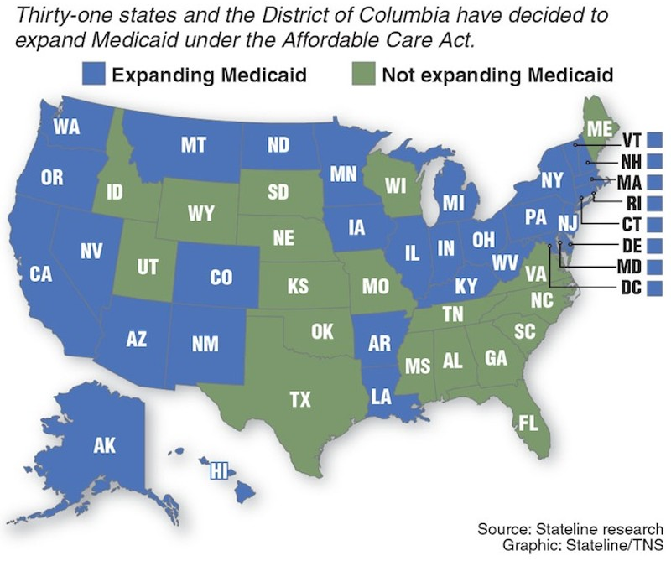
MEDICAID EXPANSION 2017

Slide 22
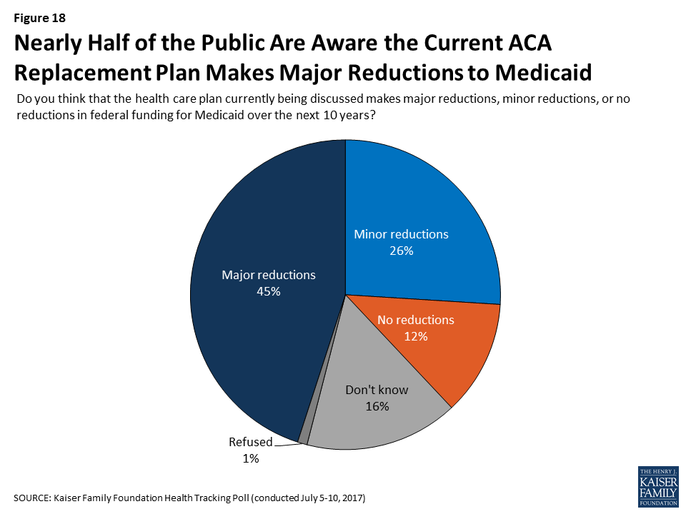
RESULTS OF KFF POLL ON MAJOR REDUCTIONS TO MEDICAID
Nearly half of the public are aware the current ACA replacement plan makes major reductions to Medicaid.
THE MAJORITY OF THE PUBLIC OPPOSE MAJOR REDUCTIONS TO MEDICAID.
When told about the reduction in federal funding for Medicaid, the majority of the public (65%) oppose major reductions to Medicaid as part of a plan to repeal and replace the ACA.

Slide 23
WORK IN BIPARTISAN MANNER TO IMPROVE ACA

Slide 24
BIPARTISAN EFFORTS
“The Problem Solvers Caucus” Audie Cornish NPR Interview on “All Things Considered” 7/31/17
Bipartisan House/Senate group working on fixing ACA
57 US mayors cite opioids, guns and obesity as greatest problems; majority favor single payer
16 attorneys general

Slide 25
COLORADO NOW
Where do Coloradans get insurance?
50% employer
6% individual
500,000 in exchanges
6.7% uninsured
7 insurers on exchange
All counties have at least one insurer
La Plata: Anthem BC/BS, Cigna
Montezuma: Anthem BC/BS
Archuleta: Anthem BC/BS
Proposed 2018 rates to be released next month
Anthem BC/BS profits up 44% first quarter 2017
Increases are expected – estimated average 27%
Colorado exchange – Connect for Health Colorado
Open enrollment 11/1/17 – 1/12/18

Slide 26
CHAS – COLORADO HEALTH ACCESS SURVEY
10,136 households surveyed on health insurance coverage, access and use of healthcare services
2017 survey results will be delivered by team from Colorado Health Institute
Cortez: 9/19/17, 1:00-2:30 p.m. at library
Durango: 9/19/17, 9:00-10:30 p.m. at rec center

Slide 27
THE EFFECTS OF HEALTH INSURANCE ON HEALTH AND SURVIVAL

Slide 28
THE EFFECTS OF HEALTH INSURANCE ON HEALTH AND SURVIVAL (Continued)

Slide 29
INFORMATION SOURCES
ORGANIZATIONS
Indivisible Durango (Healthcare Committee) indivisibledurango@gmail.com
Colorado Foundation for Universal Health Care couniversalhealth.org/
Colorado Health Institute coloradohealthinstitute.org/
CHAC – Community Health Action Coalition chaclaplata.org
BOOKS
An American Sickness by Elizabeth Rosenthal, 2017
The Healing of America by T.R. Reid, 2009
The Health Gap: The Challenge of an Unequal World by Michael Marmot, 2015
Prescription for the Future: The Twelve Transformational Practices of Highly Effective Medical Organizations by Ezekiel J. Emanuel, 2017

Slide 30
INFORMATION SOURCES (Continued)
Generally Considered Reliable (Some considered liberal bias, most not)
AARP
CDC
Center for Public Integrity
Christian Science Monitor
Commonwealth Fund
Frontline
Harvard University T. H. Chan School of Public Health
The Hill
Kaiser Family Foundation
NPR
New York Times
PBS
Politico
ProPublica
Washington Post

